Slide 1
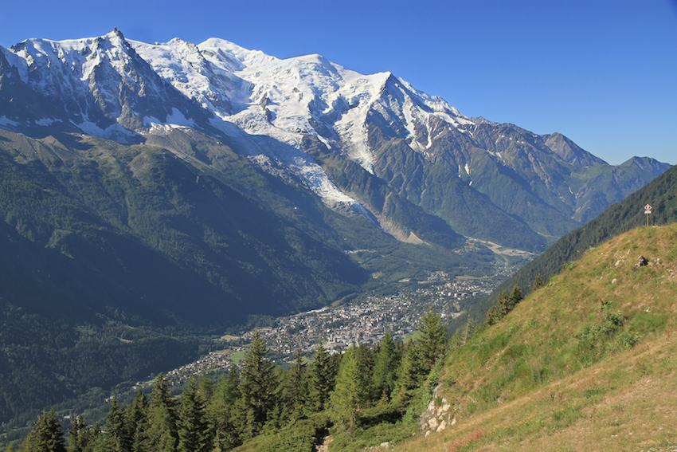
Mont-Blanc range and Chamonix valley, French Alps
State and fate of glaciers: what do we know? How do we measure and model it?
Dr. Antoine RABATEL, Institut des Géosciences de l’Environnement 2020, April 17

Slide 2
I. Overview of current glaciers evolution II. A glimpse on glacier monitoring: from in situ to remote sensing methods III. A glimpse on glacier modeling: one question, one model! IV. Future glacier changes and impacts
Contents
A. Rabatel

Slide 3
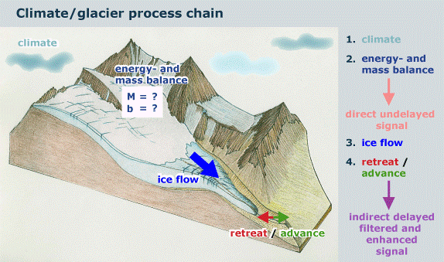
Before starting
A glacier is an natural accumulation of solid water resulting from the metamorphism of snow into ice, slowly moving, and considered as permanent at human time scale
Glacier mass changes are directly related to changes in climate
Glacier geometry changes are an indirect and smoothed response to changes in climate due to the ice dynamics
A. Rabatel

Slide 4
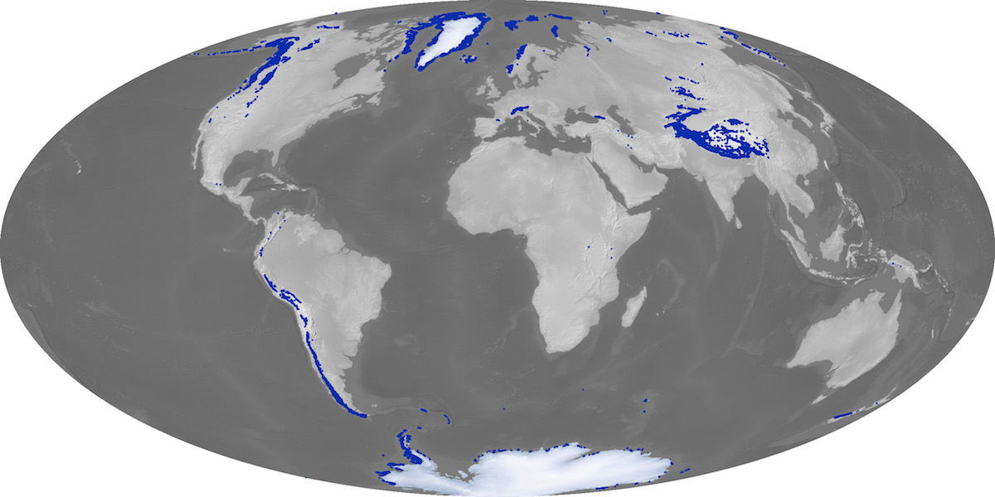
I. Overview of current glaciers evolution
RGI glacier distribution (NASA, 2013)
Distribution of glaciers worldwide (~700,000 km² , ~0.4 m SLR)
Ice sheets ~60-70 m SLR
A. Rabatel

Slide 5
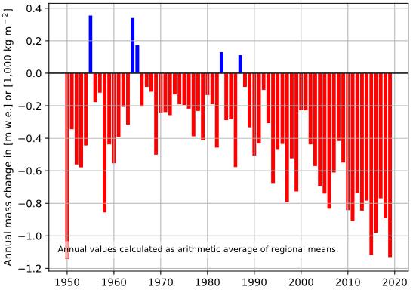
I. Overview of current glaciers evolution
Mass changes since the 1950s from the “reference glaciers” at global scale
Data compilation by WGMS (https://wgms.ch ; 2019-04-06)
Increase in mass loss since the 2000s
1950-1990 trend
Representativeness of these glaciers?
2000-2019 trend
A. Rabatel

Slide 6
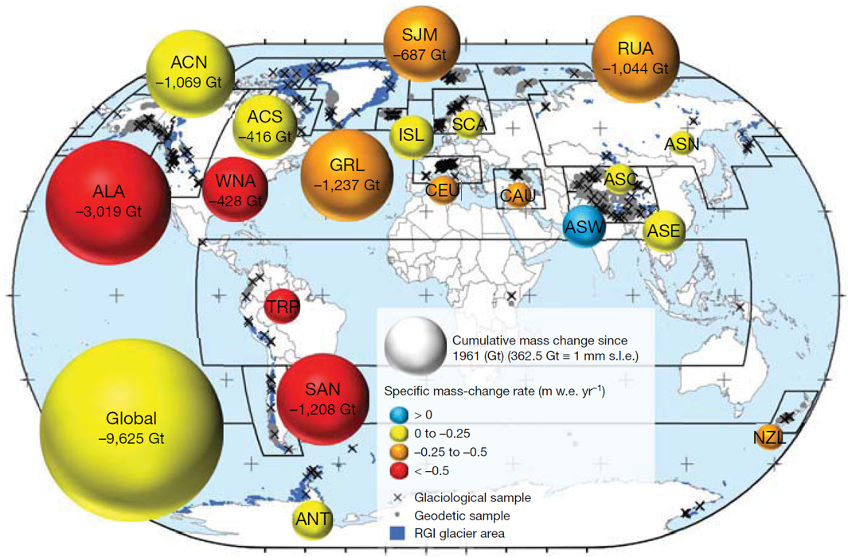
I. Overview of current glaciers evolution
Regional glacier mass change, 1961-2016. Combination of in situ monitoring and geodetic mass balance
Limitations
The inter-annual variability, constrained by in situ monitoring, is poorly documented in many regions due to the scarcity of long-term SMB monitoring.
Zemp et al., Nature, 2019
A. Rabatel

Slide 7
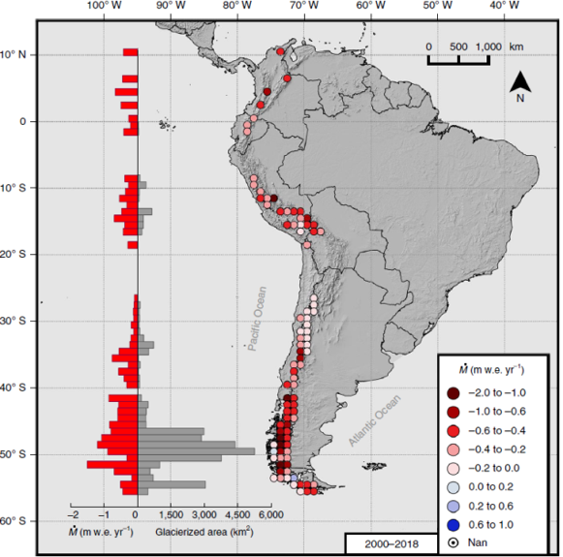
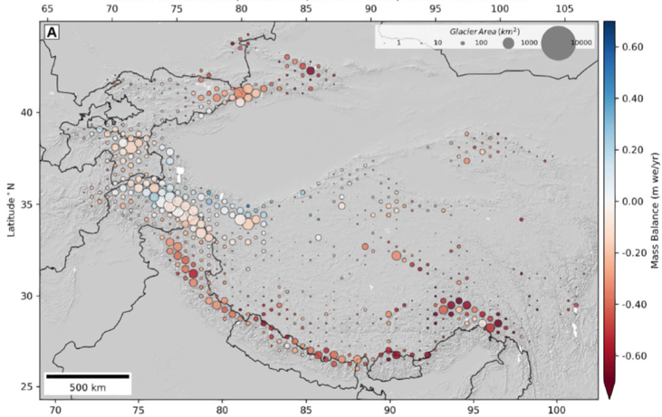
I. Overview of current glaciers evolution
Multi-decadal mass balance estimates are now widely accessible from DEMs differencing of multi-DEMs trends (e.g. ASTERiX method)
ASTER optical stereo images recorded since 2000
Average annual mass loss for individual glaciers (> 0.5 km²) at a decadal time scale
Interannual variability is not resolved
High-Mountain of Asia
Dussaillant et al., Nat. Geosc., 2019
32,000 km² of glaciers
Loss of 22.9± 5.9 Gt/yr [2000-2018]
Shean et al., Frontiers Earth Sci., 2020
50,000 km² of glaciers
Loss of 19.0 ± 2.5 Gt/yr [2000-2018]
A. Rabatel

Slide 8
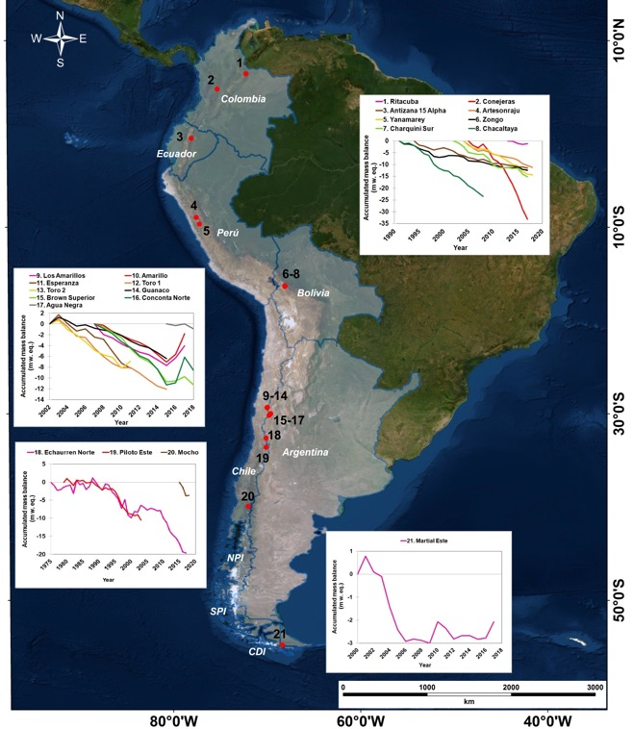
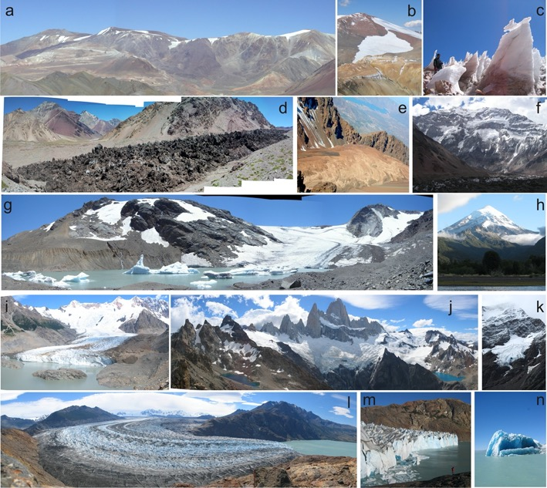
I. Overview of current glaciers evolution
Long term in situ surface mass balance are limited.
Whereas the state of the glaciers is highly diverse
Masiokas et al., Frontiers Earth Sci., in press
A. Rabatel

Slide 9
I. Overview of glaciers temporal evolution II. A glimpse on glacier monitoring: from in situ to remote sensing methods III. A glimpse on glacier modeling: one question, one model! IV. Future glacier changes and impacts
Contents
A. Rabatel

Slide 10
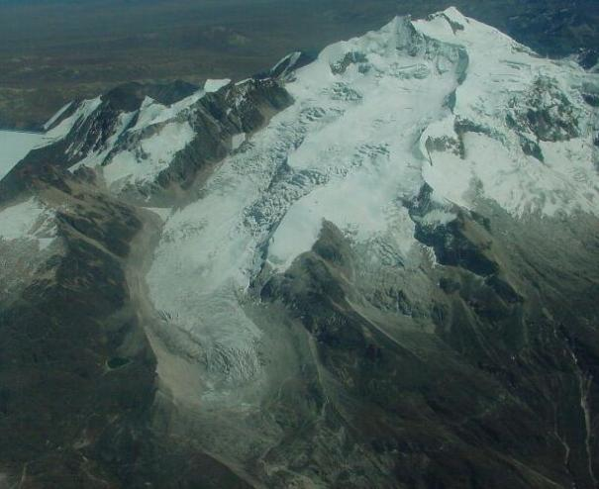
II. A glimpse on glacier monitoring
Surface area
Length
Snout position
Accumulation
Ablation
Energy balance
Flow velocity
Ice thickness
Precipitation
Runoff
Ph : B. Pouyaud
A. Rabatel

Slide 11
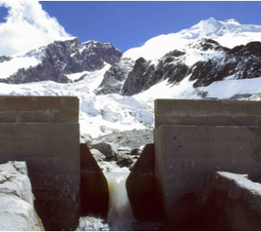
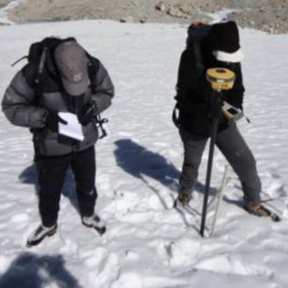
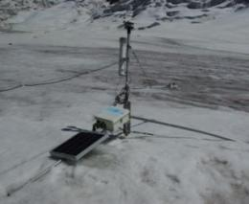
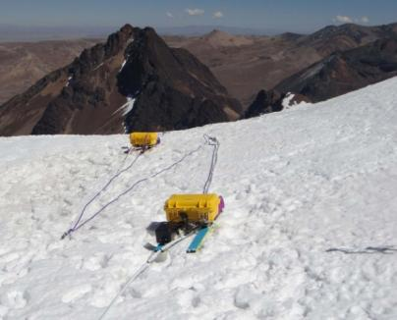
II. A glimpse on glacier monitoring
In situ measurements
Hydrological balance
Surface mass balance
Topographical measurements
Meteorological measurements
Surface energy balance
Ice thickness measurements
A. Rabatel

Slide 12
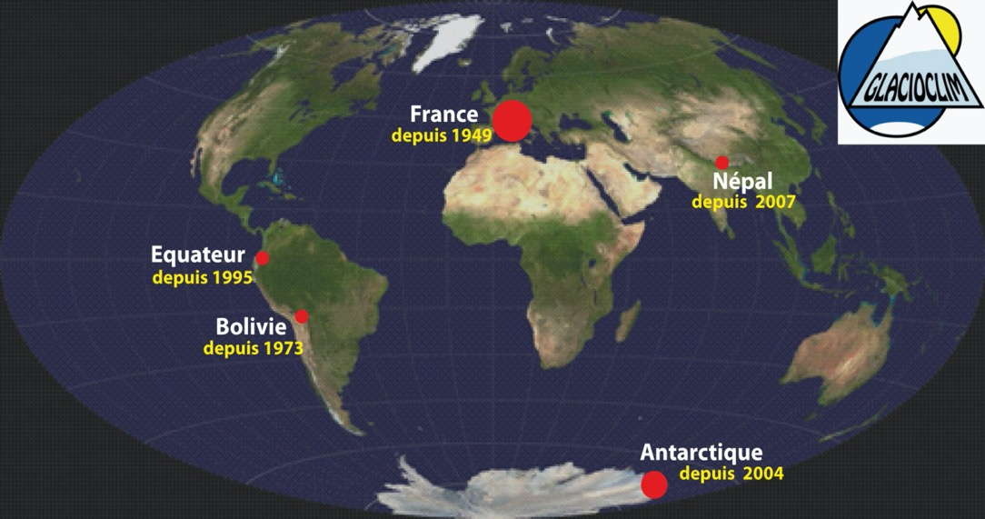
II. A glimpse on glacier monitoring
Service National d’Observation GLACIOCLIM
https://glacioclim.osug.fr/
A. Rabatel

Slide 13
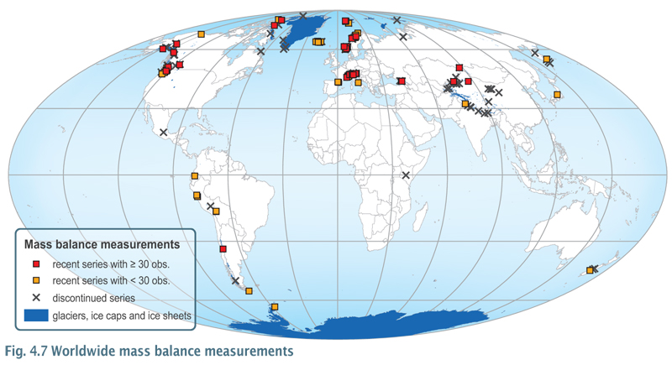
II. A glimpse on glacier monitoring
Glaciers with direct mass balance measurements worldwide
~150 glaciers among the >200,000 inventoried (0.06 %)
Only 40 glaciers with a >40yr continuous time series
Limitations
Human, temporal, financial investment
Representativeness
Zemp et al., J. Glaciol., 2015
A. Rabatel

Slide 14
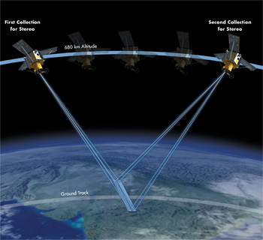
II. A glimpse on glacier monitoring
Remote sensing data: a complementary source of in situ measurements, both temporally and spatially
Aerial photographs (since the mid 20th C)
Satellite optical images (since the 1970s for civil platforms, and since 1950s for military “spy” data (now partly accessible))
Satellite Radar data
Satellite Lidar data
© DigitalGlobe
A. Rabatel

Slide 15
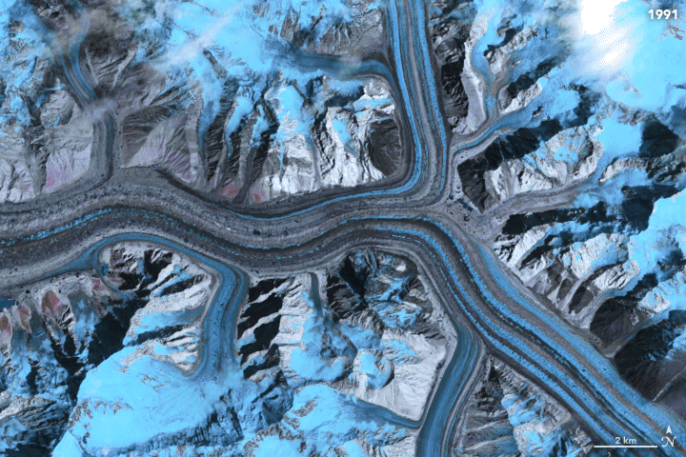
II. A glimpse on glacier monitoring
Temporal repetitiveness allows monitoring the changes in surface states:
Glacier surface area
Snow cover
Surface albedo
Debris cover
Surface flow velocity
Source: A. Dehecq, JPL, Nasa
A. Rabatel

Slide 16
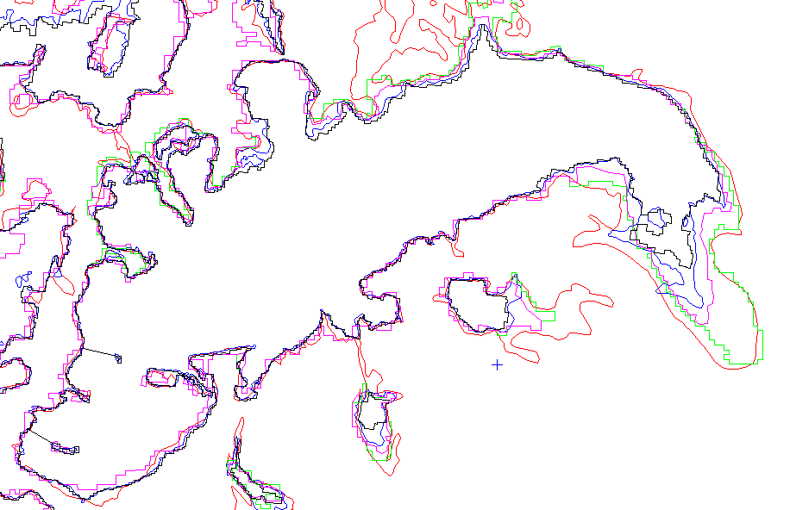
II. A glimpse on glacier monitoring
Multi-temporal glacier inventories
2015
At global scale, multi-temporal inventories are gathered through the Global Land Ice Measurements from Space (GLIMS)
www.glims.org
2009
2003
1985
1971
Glacier Blanc
French Alps
A. Rabatel

Slide 17
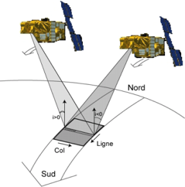
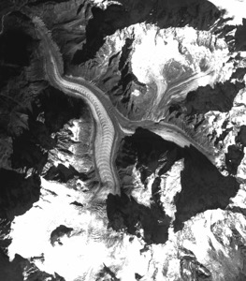
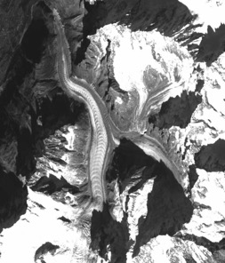
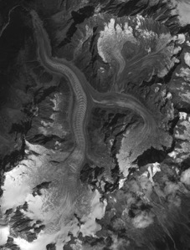
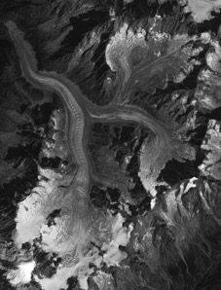
II. A glimpse on glacier monitoring
Glacier volume changes
2003
2012
Stereoscopic effect
DEM #1
DEM #2
DEM #2 - DEM #1
= DEM differencing
 Glacier surface elevation change => average surface mass balance
A. Rabatel

Slide 18
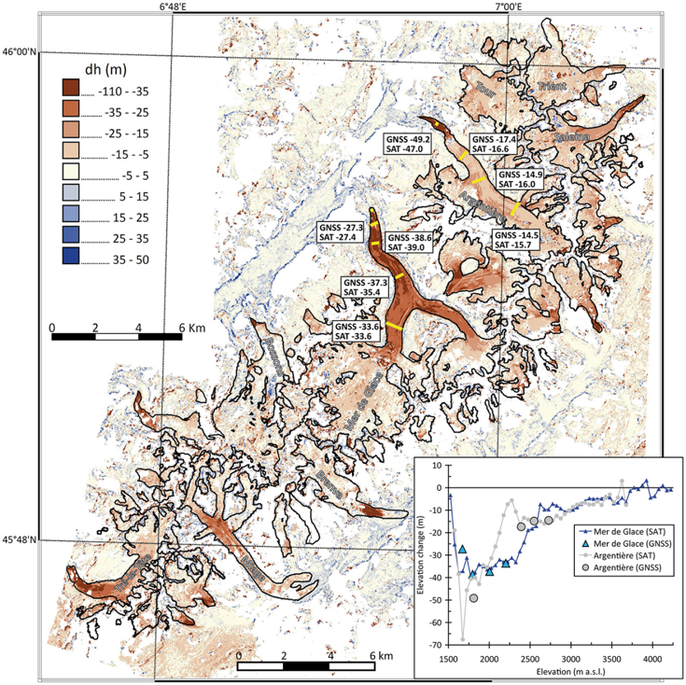
II. A glimpse on glacier monitoring
Glacier volume changes
Difference between 2 DEMs
elevation change of the glacier surface (dh/dt)
Ex: Mont-Blanc range (French Alps), from one SPOT5 DEM (2003) and one Pléiades DEM (2012)
Berthier et al., Frontiers Earth Sci., 2014
A. Rabatel

Slide 19
II. A glimpse on glacier monitoring
Glacier volume changes
Source: I. Dussaillant (2018)
A. Rabatel

Slide 20
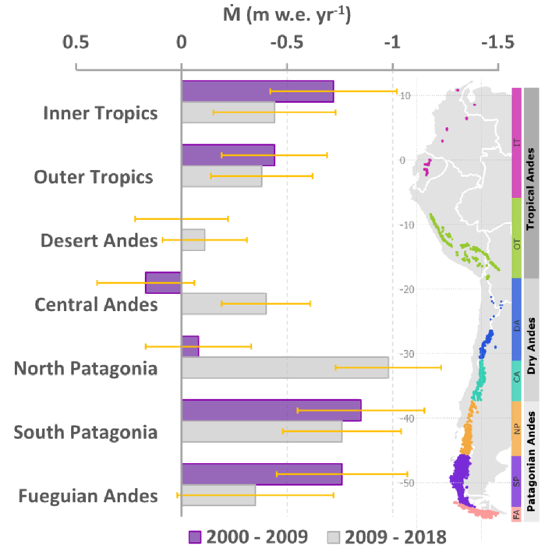
II. A glimpse on glacier monitoring
Glacier volume changes: a zoom into the Andes
Application of the ASTERiX method for the periods 2000-09 and 2009-2018
Contrasted pattern regionally:
Mass change almost constant in the Tropics and in South Patagonia (i.e. NPI & SPI).
Strong increase in mass loss in the subtropical Andes and up to 45°S => mega-drought
Dussaillant et al., Nature Geosci., 2019
A. Rabatel

Slide 21
II. A glimpse on glacier monitoring
Glacier volume changes: current limitations and other methods not presented here
Results are obtained a multiannual time scales (e.g. a decade) due to the spatial resolution of images
Global estimate for individual glaciers can be obtained since the early 2000s
To go back in time:
Use of aerial stereo-photographs (since ~1940-50)
Use of satellite “spy images” (since ~1960-70)
A lot of work for data compilation, analysis… data treatment needs to be automatized
Other methods not presented here:
Laser altimetry: ICESat (2003-2010) and ICESat-2 (launch in October 2018)
RADAR: SRTM (Shuttle Radar Topography Mission, Feb. 2000 => global DEM)
TerraSAR-X – TanDEM-X => WorldDEM
A. Rabatel

Slide 22
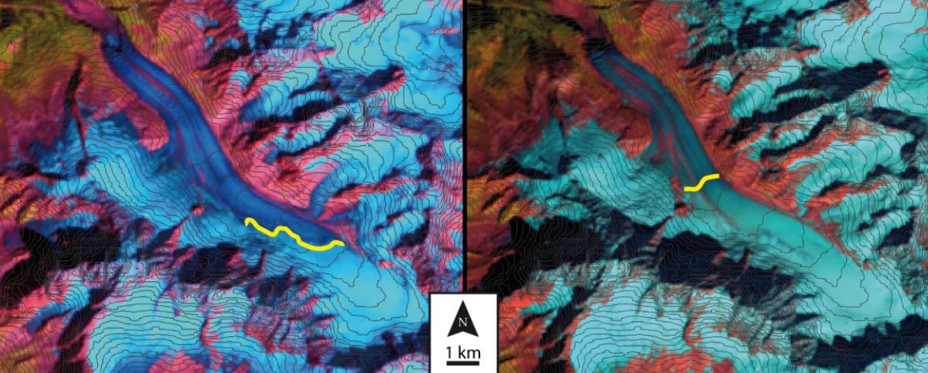
II. A glimpse on glacier monitoring
Monitoring of the equilibrium-line altitude to infer the annual surface mass balance
Glacier d’Argentière (French Alps), from optical images (e.g., LANDSAT, SPOT, ASTER, Sentinel-2)
Rabatel et al., 2005, 2008, 2012, 2013, 2016, 2017
A. Rabatel

Slide 23
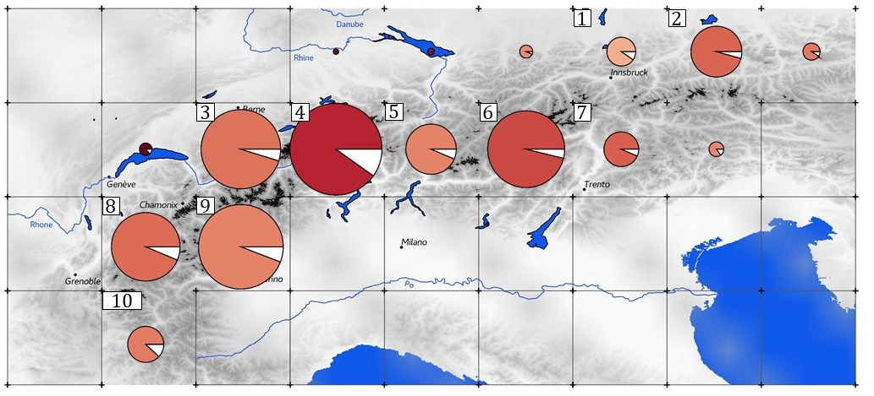
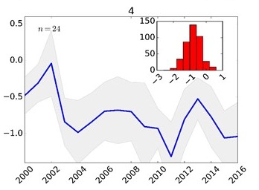
II. A glimpse on glacier monitoring
Reconstruction of annual mass balance time series [2000-2016]
239 glaciers in the European Alps (1215 km2) > 0,5 km² & Zmax > 3100 m
23 glaciers have in situ measurements over this period
Davaze et al., Frontiers Earth Sci., accepted
A. Rabatel

Slide 24
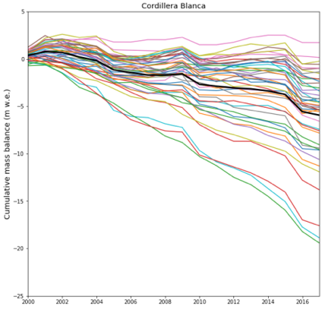
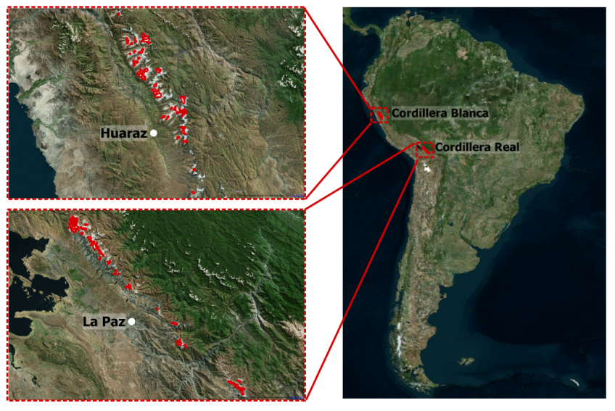
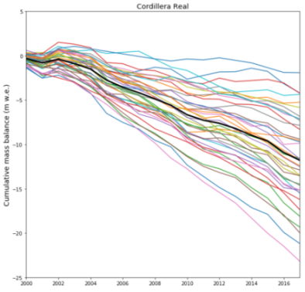
II. A glimpse on glacier monitoring
Reconstruction of annual mass balance time series [2000-2016]
82 glaciers (Peruvian & Bolivian Andes)
Only 4 glaciers have in situ measurements over this period
Regional mean
Zongo Glacier, in situ SMB
PhD L. Davaze (2019), Master thesis L. Gurriaran (2018-19)
A. Rabatel

Slide 25
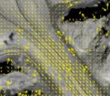
II. A glimpse on glacier monitoring
Glacier surface flow velocity
Image preparation
Workflow developed by Jérémie Mouginot, Romain Millan & Anna Derkacheva at IGE-Grenoble
Input data:
- Optical data: Landsat, Sentinel-2, …
- Radar data: ERS, Sentinel-1, …
Sensor dependent
Ice displacement calculation
Time consuming
Post-processing
Monitoring system of the processing states.
Works in parallel with the workflow.
Millan et al., Remote Sensing, 2019
Ice velocity
A. Rabatel

Slide 26
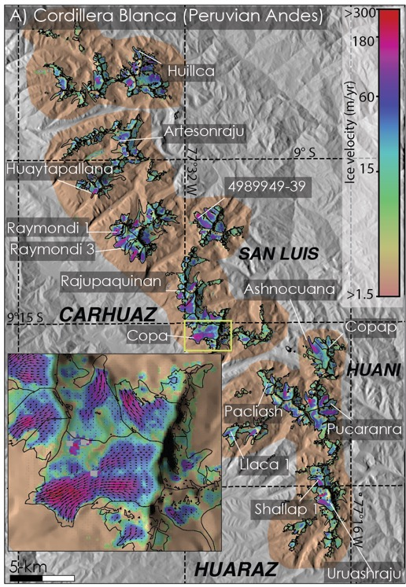
II. A glimpse on glacier monitoring
Glacier surface flow velocity
Cordillera Blanca (Peruvian Andes)
Period 2017-2018: synthetic map
Images Sentinel-2 (10 m)
Fox Glacier (New Zealand)
Period 2017-2018: time series
Images: Landsat-8 (30 m), Sentinel-2 (10 m), Venμs (5 m)
Millan et al., Remote Sensing, 2019
A. Rabatel

Slide 27
II. A glimpse on glacier monitoring
Glacier surface flow velocity: current limitations
Small glaciers (< 0.5 km²) are not resolved due to the spatial resolution of available images
Correlation methods result in higher uncertainties in the accumulation zones due to the bright snow cover (homogeneous, poor contrast, saturation, …)
Optical imagery is mostly used even if the could cover can be a limiting factor (new generation of satellites with a high revisiting time allows limiting this problem)
Other methods using satellite Radar data are also used (e.g., InSAR)
Very high resolution (i.e. quantification of very slow displacements)
No problem with clouds
BUT
Geometrical correction are more challenging in mountainous areas
Penetration of the radar signal into the snow
Less sensors
A. Rabatel

Slide 28
II. A glimpse on glacier monitoring
A common data portal
www.gtn-g.ch
A. Rabatel

Slide 29
I. Overview of glaciers temporal evolution II. A glimpse on glacier monitoring: from in situ to remote sensing methods III. A glimpse on glacier modeling: one question, one model! IV. Future glacier changes and impacts
Contents
A. Rabatel

Slide 30
III. A glimpse on glacier modeling
Plenty of approaches are available; a common feature in (geo)sciences:
Parameterized models do not explicitly resolve any physical processes, but implicitly take them into account using parameterizations based on statistical or empirical relationships.
Process-based models approximate a number of glacier physical processes and surface energy and mass balance in a simplified manner.
- Physics-based models approach glacier dynamics by explicitly simulating physical processes.
The choice of the model basically depends on:
The question to be answered
The availability of data/observation (in situ and/or remotely sensed) to calibrate, validate and test the model
For glacier evolution modeling at global scale mostly parameterized models are used, partly due to the lack of observations
A. Rabatel

Slide 31
III. A glimpse on glacier modeling
What to we need to model glacier evolution?
Available approaches:
Parameterized models: from simple empirical relationship (e.g., ice melt = f(T°C)) to machine learning
Process-based models: simplified energy balance models
- Physics-based models: many processes still need to be considered (e.g., under-glacial hydrology, fracturing, thermical regime, …)
Surface mass balance model
Glacier dynamics model
(i.e. ice flow)
A. Rabatel

Slide 32
III. A glimpse on glacier modeling
What to we need to model glacier evolution?
Surface mass balance model
Atmospheric forcings unfortunately not available at high spatial resolution (e.g., ~100 m²)
Glacier dynamics model
(i.e. ice flow)
Glacier ice thickness distribution
A major unknown, main uncertainty in future glacier evolution
A. Rabatel

Slide 33
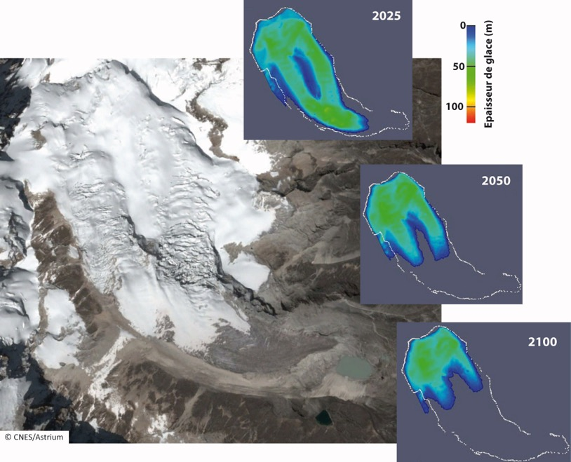
III. A glimpse on glacier modeling
Example of glacier modeling results
Projections of Zongo Glacier (Bolivia)
Surface mass balance is modeled using a parameterized approach forced with atmospheric temperature scenarios from CMIP5
Glacier dynamics is modeled using a physics-based approach (Elmer/Ice full-Stoke finite elements model)
For this glacier, ice thickness are known from in situ measurements.
Réveillet et al., Ann. Glaciol., 2015
A. Rabatel

Slide 34
I. Overview of glaciers temporal evolution II. A glimpse on glacier monitoring: from in situ to remote sensing methods III. A glimpse on glacier modeling: one question, one model! IV. Future glacier changes and impacts
Contents
A. Rabatel

Slide 35
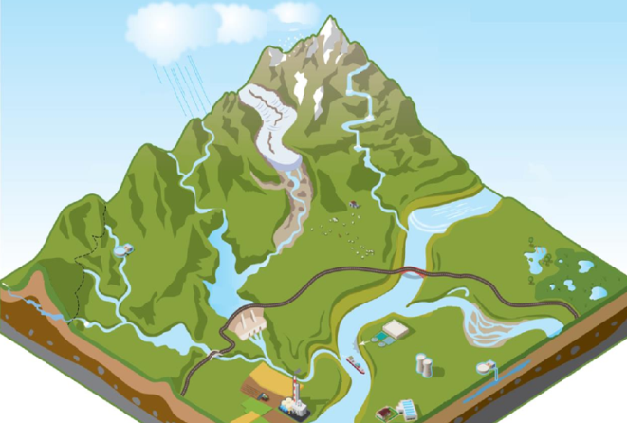
IV. Future glacier changes and impacts
Water resources
Irrigation
Hydro-power generation
Human consumption
Hazards
Glacial lake outburst floods (GLOFs)
Serac falls
Glacier destabilization
Sea Level Rise (SLR)
To the sea
A. Rabatel

Slide 36
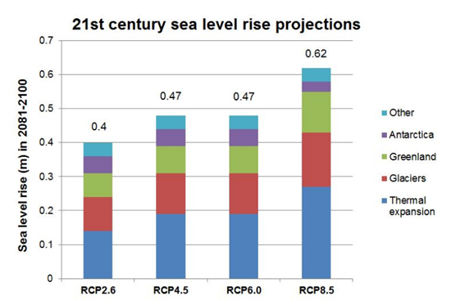
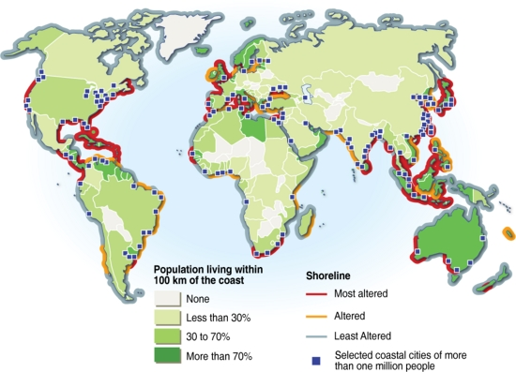
IV. Future glacier changes and impacts
Evolution of sea level = global phenomena
Coastal population
Source: IPCC
Glaciers + ice sheets = 1st contributor to SLR during the 20th Century and in the projections for the 21st Century
Source: P. Rekacewicz, H. Ahlenius (UNEP/GRID-Arendal)
A. Rabatel

Slide 37
IV. Future glacier changes and impacts
Global glacier projections [2015-2100]
GlacierMIP – A model intercomparison of global-scale glacier mass-balance models and projections
6 glaciological models
25 GCMs
4 RCPs
19 glacierized regions of the RGI
-18%
-18%
-21%
-30%
-40%
-56%
Multi-model mean
Hock et al., J. Glaciol., 2019
Individual GCMs
A. Rabatel

Slide 38
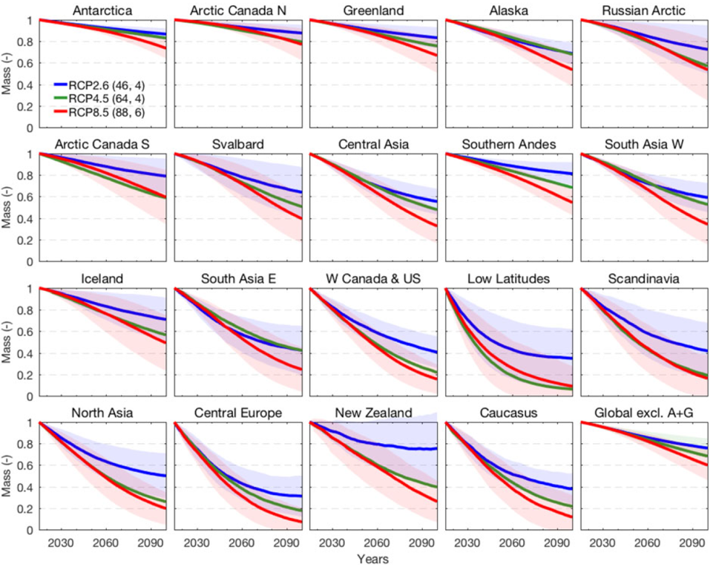
IV. Future glacier changes and impacts
Global glacier projections, a zoom into different regions [2015-2100]
Strong regional differences in glacier changes
Hock et al., J. Glaciol., 2019
A. Rabatel

Slide 39
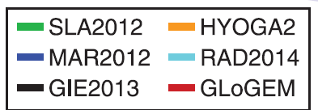
IV. Future glacier changes and impacts
Glacier contribution to sea level according to different RCP [2015-2100]
RCP2.6
RCP4.5
RCP8.5
175 mm
125 mm
80 mm
80 mm
80 mm
50 mm
Hock et al., J. Glaciol., 2019
Cumulative sea-level equivalent
60-80% would come from Antarctic periphery, Alaska and Arctic regions (depending on RCP and models)
A. Rabatel

Slide 40
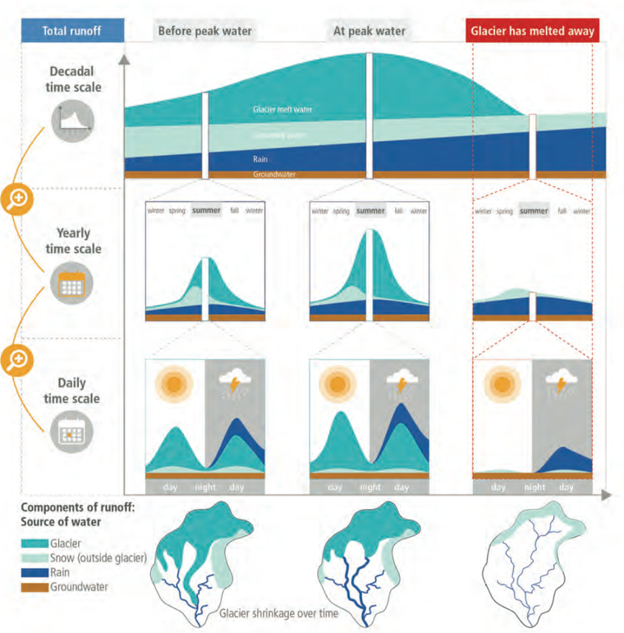
IV. Future glacier changes and impacts
Impacts on water resources
Whatever the timescale
Decrease in runoff
Changes in the hydrological regime
IPCC Special Report on the Ocean and Cryosphere in a Changing Climate, 2019
A. Rabatel

Slide 41
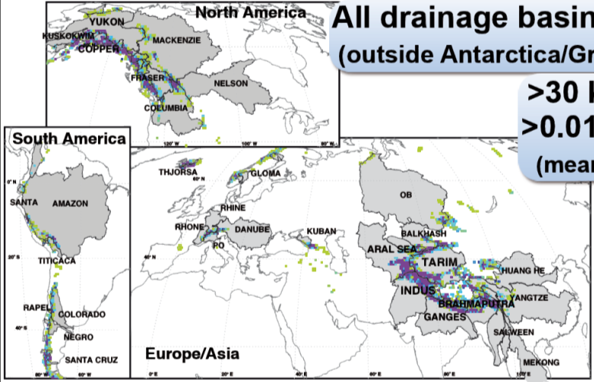
IV. Future glacier changes and impacts
Impacts on water resources
Modeling global glacier runoff changes: Huss and Hock, Nature Clim. Change, 2018
All catchments >5,000 km² with >30 km² of ice cover (~>0.01% ice cover, mean 2.9%)
56 catchments (~113,000 glaciers)
A. Rabatel

Slide 42
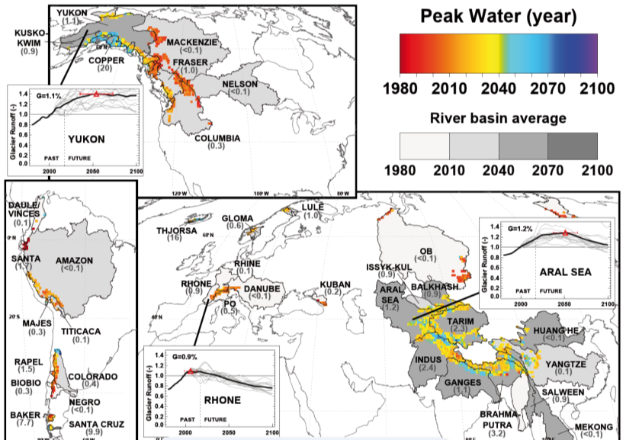
IV. Future glacier changes and impacts
Impacts on water resources
Simulated timing of the peak water in the 56 glacierized catchments
Later peak water for catchments with largest ice cover
Huss and Hock, Nature Clim. Change, 2018
A. Rabatel

Slide 43
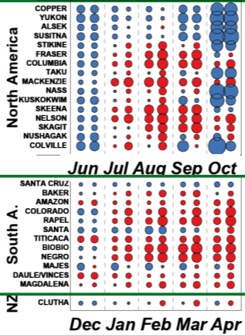
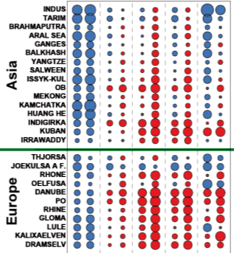
IV. Future glacier changes and impacts
Impacts on water resources
Monthly melt season glacier runoff changes in the 56 glacierized catchments (for RCP4.5)
1st column = 2050
2nd column = 2100
Huss and Hock, Nature Clim. Change, 2018
A. Rabatel

Slide 44
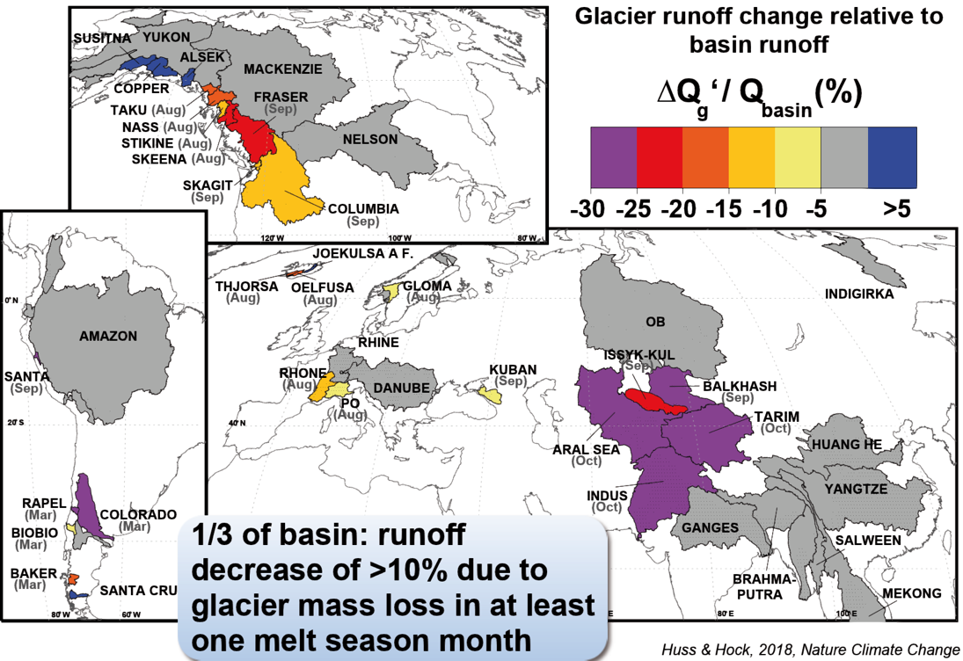
IV. Future glacier changes and impacts
Impacts on water resources
Where do glacier runoff changes matter?
Huss and Hock, Nature Clim. Change, 2018
A. Rabatel

Slide 45
Take home messages
Acceleration of the glacier mass loss on a global scale (with a few rare exceptions) since the beginning of the 21st Century.
Glaciers are a major contributor to current sea level rise
Depending on the RCPs glaciers mass loss by 2100 ranges between 18 to 56%
Which represents a sea level equivalent of 5-18 cm with a potential rate up to 3 mm/yr (RCP8.5)
The impact of glacial mass loss on hydrological functioning varies greatly depending on:
The distance to glaciers
The climate regime (i.e. temperate, tropical, polar)
The season
At global scale, 1/3 of the glacierized catchments will experience a decrease in runoff >10% in at least one month of the melt season
A. Rabatel

Slide 46
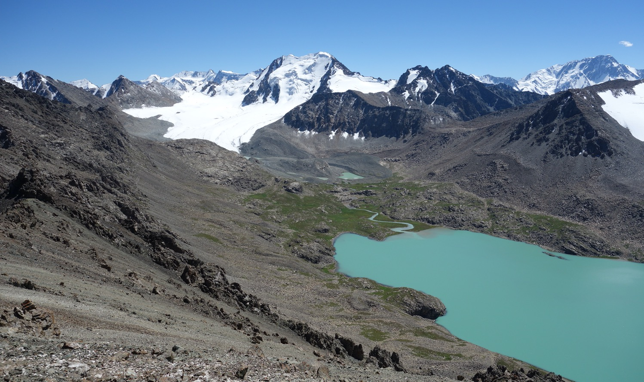
Tian Shan, Kyrgyzstan
Thank you for your attention
antoine.rabatel@univ-grenoble-alpes.fr

Slide 47
References
Berthier, E. et al. (2014). Glacier topography and elevation changes derived from Pléiades sub-meter stereo images. The Cryosphere, 8(6), 2275-2291.
Davaze, L. et al. (2020). Region-wide annual glacier surface mass balance for the European Alps from 2000 to 2016. Frontiers in Earth Science – Cryospheric Sciences, accepted.
Dussaillant, I. et al. (2019). Two decades of glacier mass loss along the Andes. Nature Geoscience, 12(10), 802-808.
Huss, M. & R. Hock (2018). Global-scale hydrological response to future glacier mass loss. Nature Climate Change, 8(2), 135.
Hock, R., et al. (2019). GlacierMIP – A model intercomparison of global-scale glacier mass-balance models and projections. Journal of Glaciology, 65(251), 453-467.
IPCC Special Report on the Ocean and Cryosphere in a Changing Climate. H.-O. Pörtner, D.C. Roberts, V. Masson-Delmotte, P. Zhai, M. Tignor, E. Poloczanska, K. Mintenbeck, M. Nicolai, A. Okem, J. Petzold, B. Rama, N. Weyer (eds.). 2019.
Masiokas, M. et al. (2020). A review of the current state and recent changes of the Andean cryosphere. Frontiers in Earth Science – Cryospheric Sciences, accepted.
Millan, R. et al. (2019). Mapping surface flow velocity of glaciers at regional scale using a multiple sensors approach. Remote Sensing, 11(21), 2498.
Rabatel, A. et al. (2005). Using remote-sensing data to determine equilibrium-line altitude and mass-balance time series: validation on three French glaciers, 1994-2002. Journal of Glaciology, 51 (175), 539-546.
Rabatel, A. et al. (2008). Twenty-five years of equilibrium-line altitude and mass balance reconstruction on the Glacier Blanc, French Alps (1981-2005), using remote-sensing method and meteorological data. Journal of Glaciology, 54 (185), 307-314.
Rabatel, A. et al. (2012). Can the snowline be used as an indicator of the equilibrium line and mass balance for glaciers in the outer tropics? Journal of Glaciology, 58 (212), 1027-1036.
Rabatel, A. et al. (2013). Changes in glacier equilibrium-line altitude in the western Alps from 1984 to 2010: evaluation by remote sensing and modeling of the morpho-topographic and climate controls. The Cryosphere, 7(5), p-1455.
Rabatel, A. et al. (2016). Spatio-temporal changes in glacier-wide mass balance quantified by optical remote sensing on 30 glaciers in the French Alps for the period 1983–2014. Journal of Glaciology, 62(236), 1153-1166.
Rabatel, A. et al. (2017). Annual and seasonal glacier wide surface mass balance quantified from changes in glacier surface state: a review on existing methods using optical satellite imagery. Remote Sensing, 9 (5), 507.
Rekacewicz, P., & H. Ahlenius (UNEP/GRID-Arendal)
Réveillet, M. et al. (2015). Simulations of changes in Glaciar Zongo (Bolivia, 16°S) over the 21st century using a 3D full-Stokes model and CMIP5 climate projections. Annals of Glaciology, 56 (70), 89-97.
Shean, D.E. et al. (2020). A Systematic, Regional Assessment of High Mountain Asia Glacier Mass Balance. Front. Earth Sci, 7, 363.
Zemp, M. et al. (2015). Historically unprecedented global glacier decline in the early 21st century. Journal of Glaciology, 61(228), 745-762.
Zemp, M. et al. (2019). Global glacier mass changes and their contributions to sea-level rise from 1961 to 2016. Nature, 568(7752), 382-386.
A. Rabatel

