Slide 1
Estabilidad del secuestro de carbono en suelos a través de un gradiente altitudinal en el sur del Perú
Adolfo Posadas^{1,2,3}
Affiliations:
¹AgriEntech Ltd., São Carlos-SP, Brazil.
²Brazilian Agricultural Research Corporation (EMBRAPA)/Embrapa Agricultural Instrumentation, São Carlos-SP, Brazil.
³University of California, Santa Barbara (UCSB), Earth Research Institute (ERI), Department of Geography, SB-CA, USA.
Contacts:
E-mail: posadasdan@gmail.com
WhatsApp: +55 16 9977-23193
Skype: aposadas1

Slide 2
Global carbon pools (Reservas mundiales de carbono)
Soil Carbon: 3rd higher pool
Fossil
5000 Pg
4000 Pg coal
500 Pg oil
500 Pg gas
Soil
2500 Pg
1550 Pg C organic
950 Pg C inorganic
Atmosphere
760 Pg
Biota
560 Pg
Ocean
38000 Pg
1 Pg = 10¹⁵ g
Los suelos de la Tierra contienen alrededor de 2.500 gigatoneladas de carbono, es decir, más de tres veces la cantidad de carbono en la atmósfera y cuatro veces la cantidad almacenada en todas las plantas y animales vivos.
Source: Adapted from Lal (2004): Soil carbon sequestration to mitigate climate change – Geoderma

Slide 3
Carbon accumulation and sequestration in the Peruvian’s soils
1. are scarcely documented (from lowlands to highlands) - as in most Andean Latin countries included in Biome B;
2. one of the challenges for the incorporation of agriculture into post-Kyoto agreements is to develop simple and effective methodologies for measuring, monitoring and verifying soil carbon in cropping soils;
¿Por qué el carbono es bueno para el suelo?
El carbono es el componente principal de la materia orgánica del suelo y ayuda a darle al suelo su capacidad de retención de agua, su estructura y su fertilidad. ... “Cuando tenemos erosión, perdemos tierra, que lleva consigo carbono orgánico, a las vías fluviales. Cuando el suelo está expuesto, se oxida, esencialmente quemando el carbono del suelo.
¿Cómo cambian los microbios la cantidad de compuestos de carbono en el suelo y dióxido de carbono en el aire?
Los microbios del suelo se mueven y transforman los compuestos de carbono y hacen que el nitrógeno sea biodisponible para las plantas. ... haciendo que los nutrientes biogeoquímicos esenciales como los compuestos de nitrógeno sean biodisponibles para las plantas y otros organismos del suelo; almacenar carbono en humus del suelo; y humus en descomposición que libera CO2 al aire a través de la respiración del suelo.

Slide 4
Soil organic matter dynamics: Importance
GLOBAL CLIMATE CHANGE
Agriculture and land use change
Quantitative:
Soil carbon stocks
Qualitative:
SOM characterization
SOM
Carbon sequestration

Slide 5
SOM characterization: Spectroscopic techniques
The use of spectroscopies allows identification of functional groups and molecular structures providing a better understanding of pathways decomposition of SOM and qualitative changes induced by management practices;
Electron Paramagnetic Resonance (EPR), Fluorescence and Nuclear Magnetic Resonance (NMR) have been used for evaluating land use and soil management effects on the humification degree of soil humic substances (HS);
The most suitable method to measure the humification degre is still discussed by researchers since that there isn’t a defined model to the HS structures. However, the integrated use of these spectroscopies can be a tool to study the dynamic of SOM and to measure stable carbon of agriculture systems, which they can be used as alternative parameters in evaluating management system quality.

Slide 6
Objectives
With the aim to determine soil carbon stocks according to soil classes, altitude, temperature gradient, climatic parameters, crop classes and native vegetation, as related to global warming, soils from main cropping systems in 5 contrasting Peruvian agroecologies within a 1,000 km transect, were sampled. Whole soil samples were also characterized using the Laser-Induced Fluorescence (LIF) Spectroscopy to assess the carbon stability in the different agroecologies.

Slide 7
Sampling-transect to assess carbon contents and stocks in Southern Peru.

Slide 8
Mean characteristics of the Peruvian soil sampling sites.
sites | Ilo | Moquegua | Torata | Puno | San Juan del’Oro
Agro eco zones | Dry lowland | Dry valley | High valley | Dry highland | humid valley
Localization | Algarrobal | Vale do Conde (“El Pacae”) | High Torata | Taraco, Saqueata (near Titicaca Lake) | San Juan del’Oro (Yanamayo - Amazônia basin)
Altitude (m) | 135 | 960 | 2.200 | 3830 | 1350
Cropping system | Maize, olive | Maize, potato, grape, orange, alfalfa, onion, beans | Avocado, potato, maize, alfalfa, manioc, | oat, alfalfa, potato | Coffee, potato, maize, coca, citrus
Precipitation (mm) | 5 | 15 | 51 | 690-834 | 2133
T mean ( °C) | 19°C | 17°C | 14°C | 8 °C | 20°C
Soil class | loam | loam | loam | clay loam | loam
Sand (%)** | 31 | 40 | 52 | 28 | 38
Silt (%)** | 49 | 42 | 32 | 39 | 42
Clay (%)** | 20 | 18 | 16 | 33 | 20
pH (H₂O)** | 6.8 | 8.1 | 7.2 | 5.7 | 4.2

Slide 9
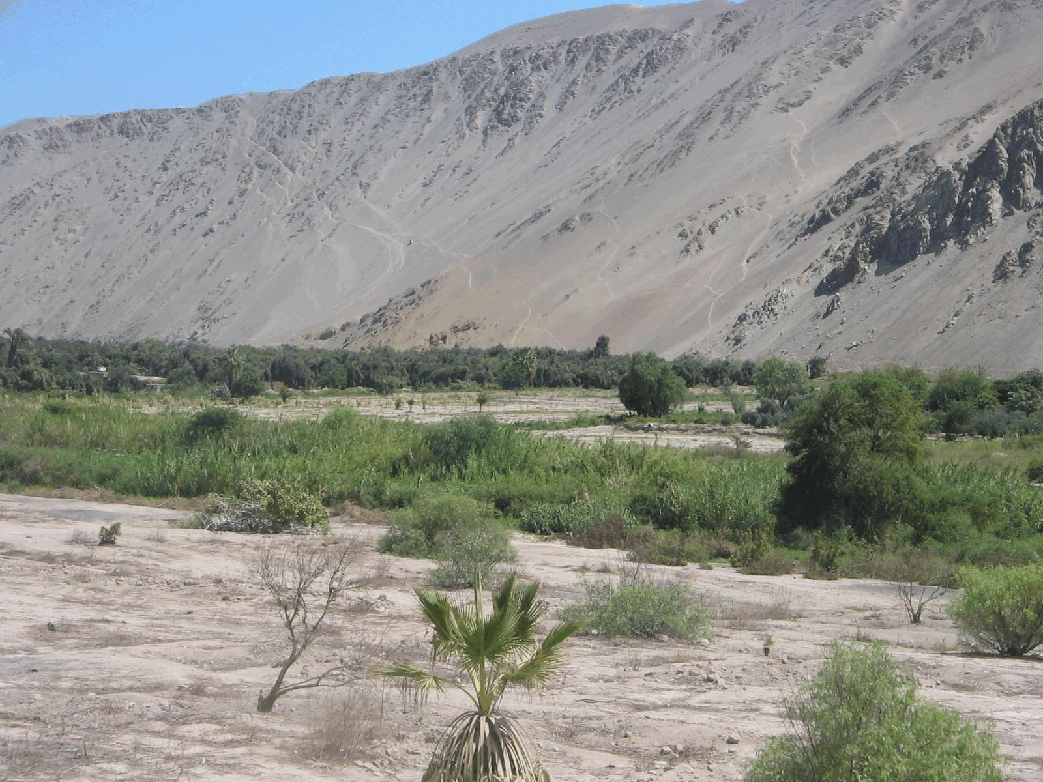
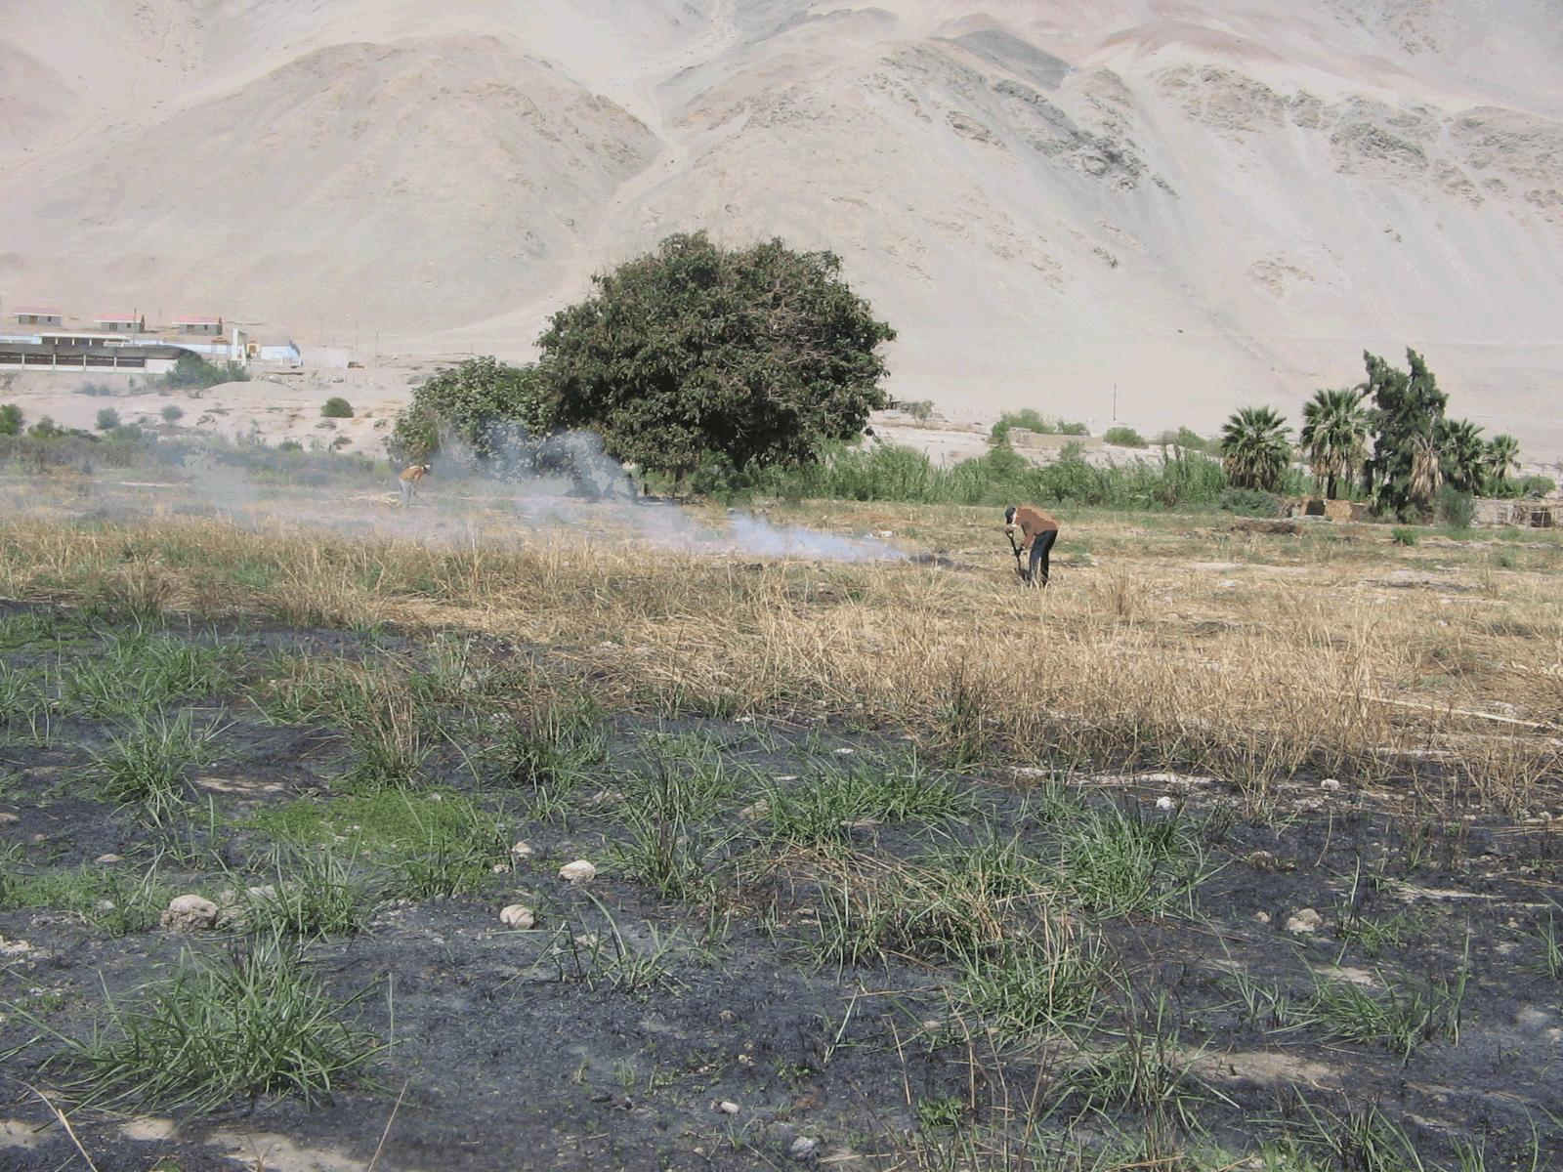
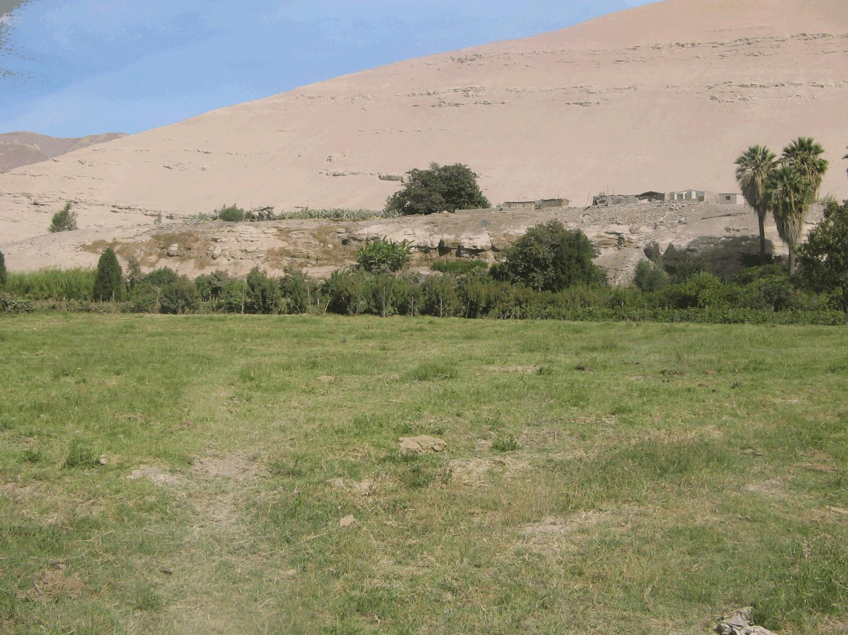
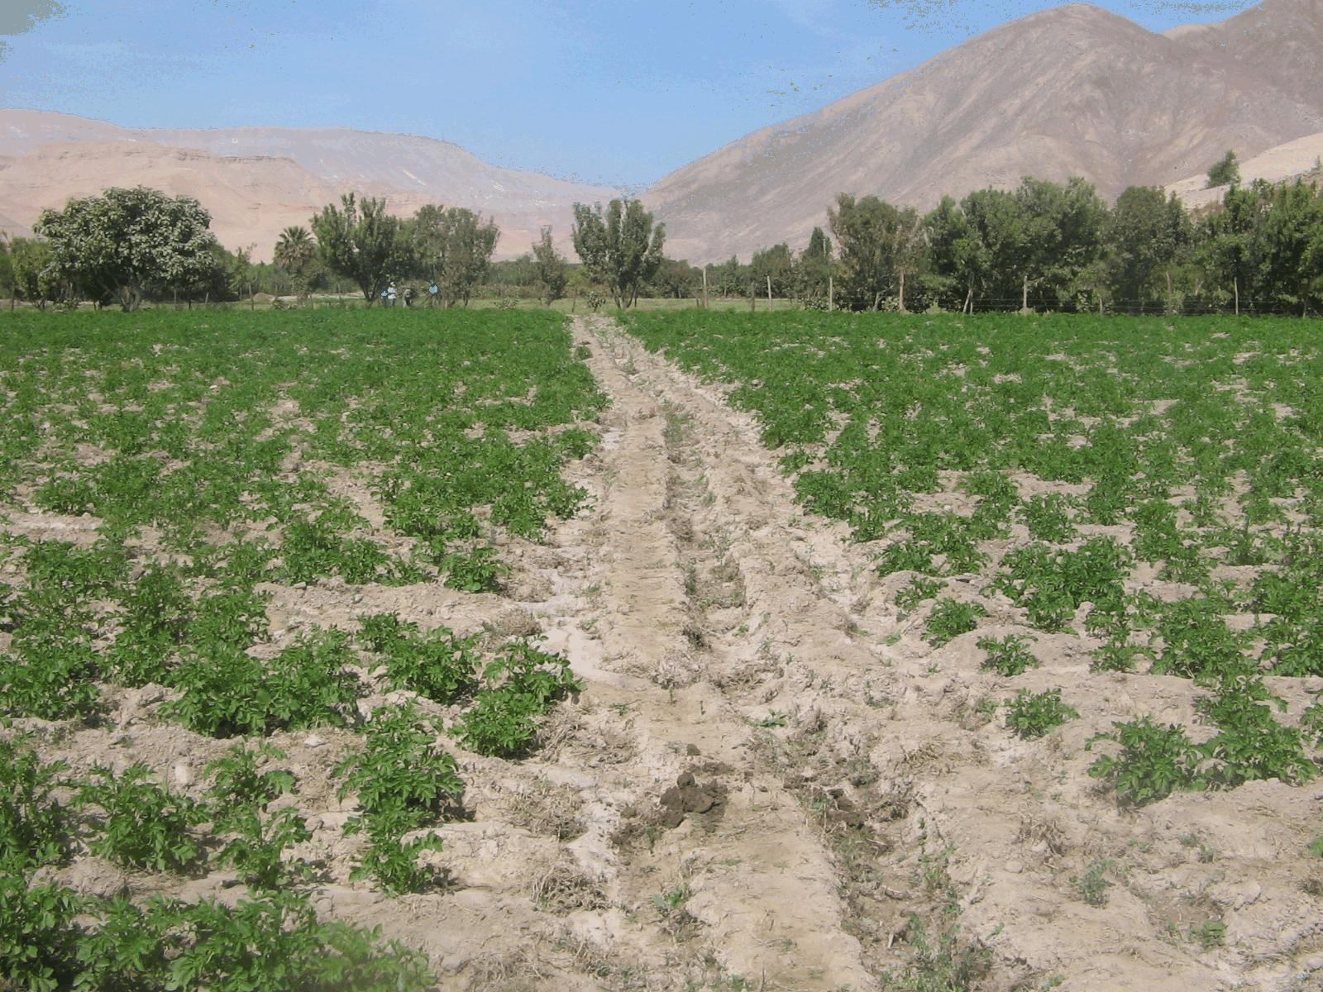
Agro eco zones:
Dry lowland
Dry valley

Slide 10
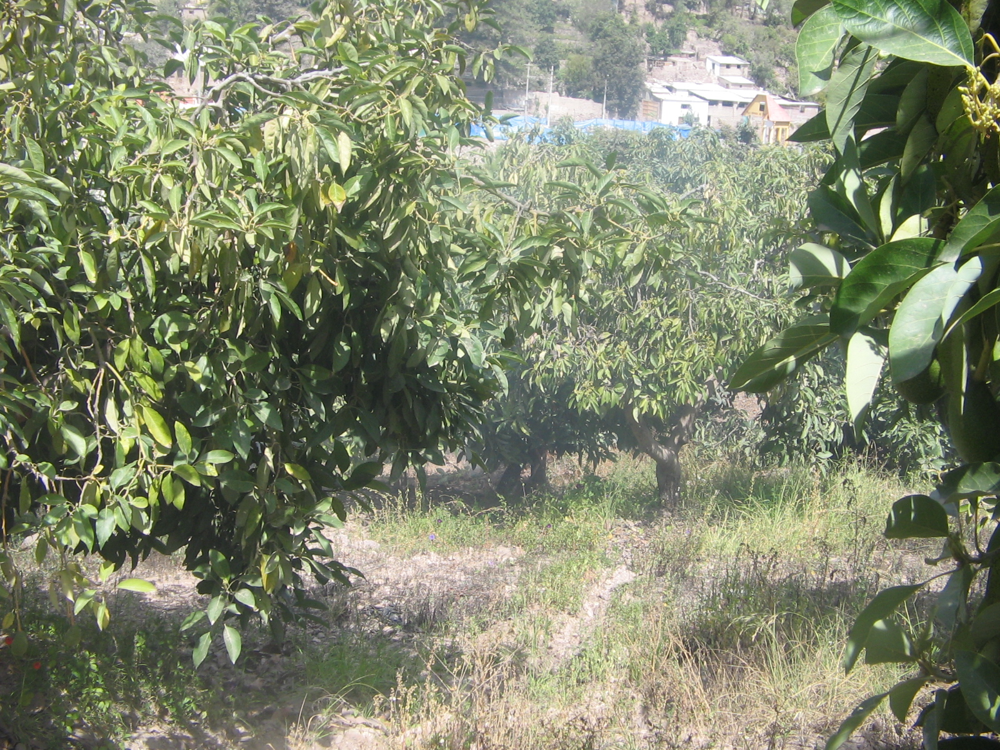
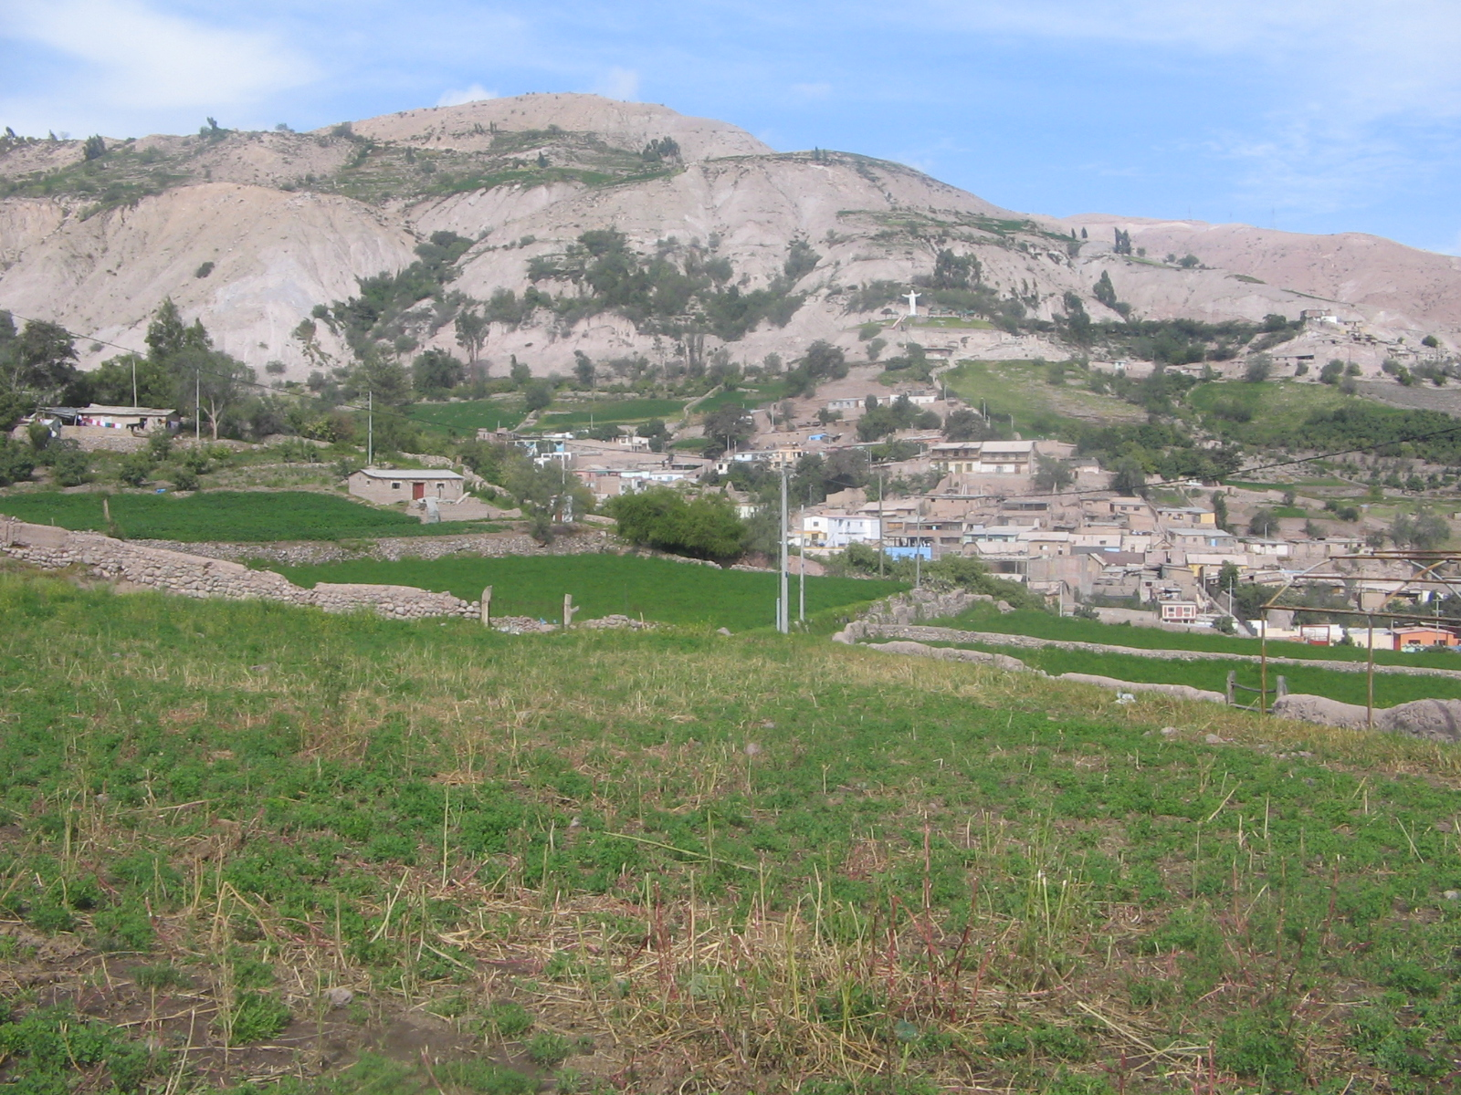
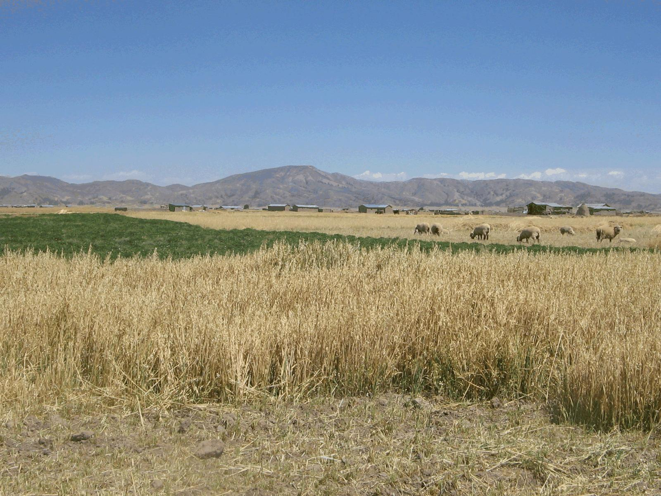
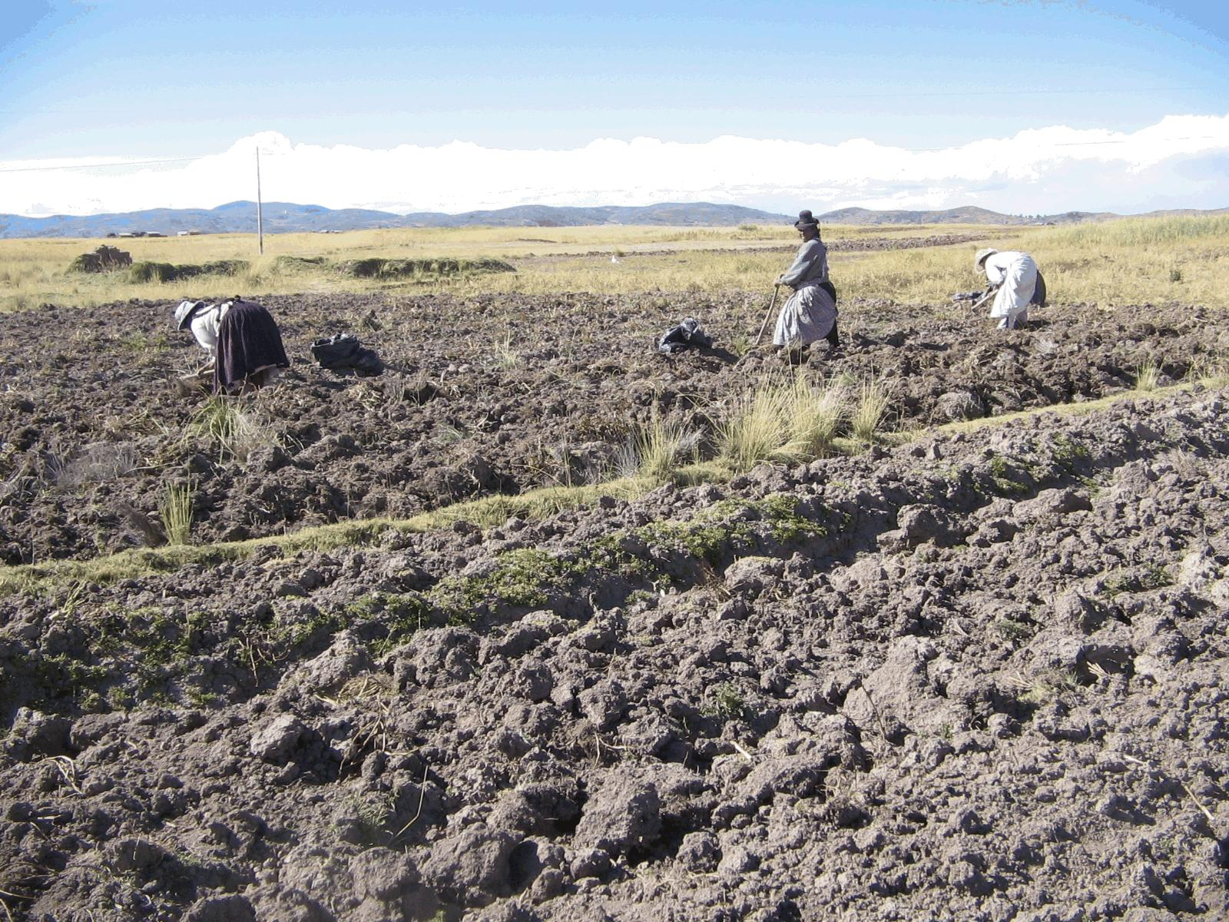
Agro eco zones:
High valley
DRY HIGHLANDS (Andes)

Slide 11
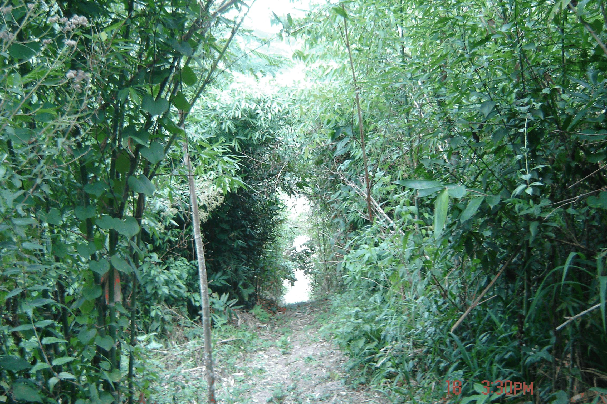
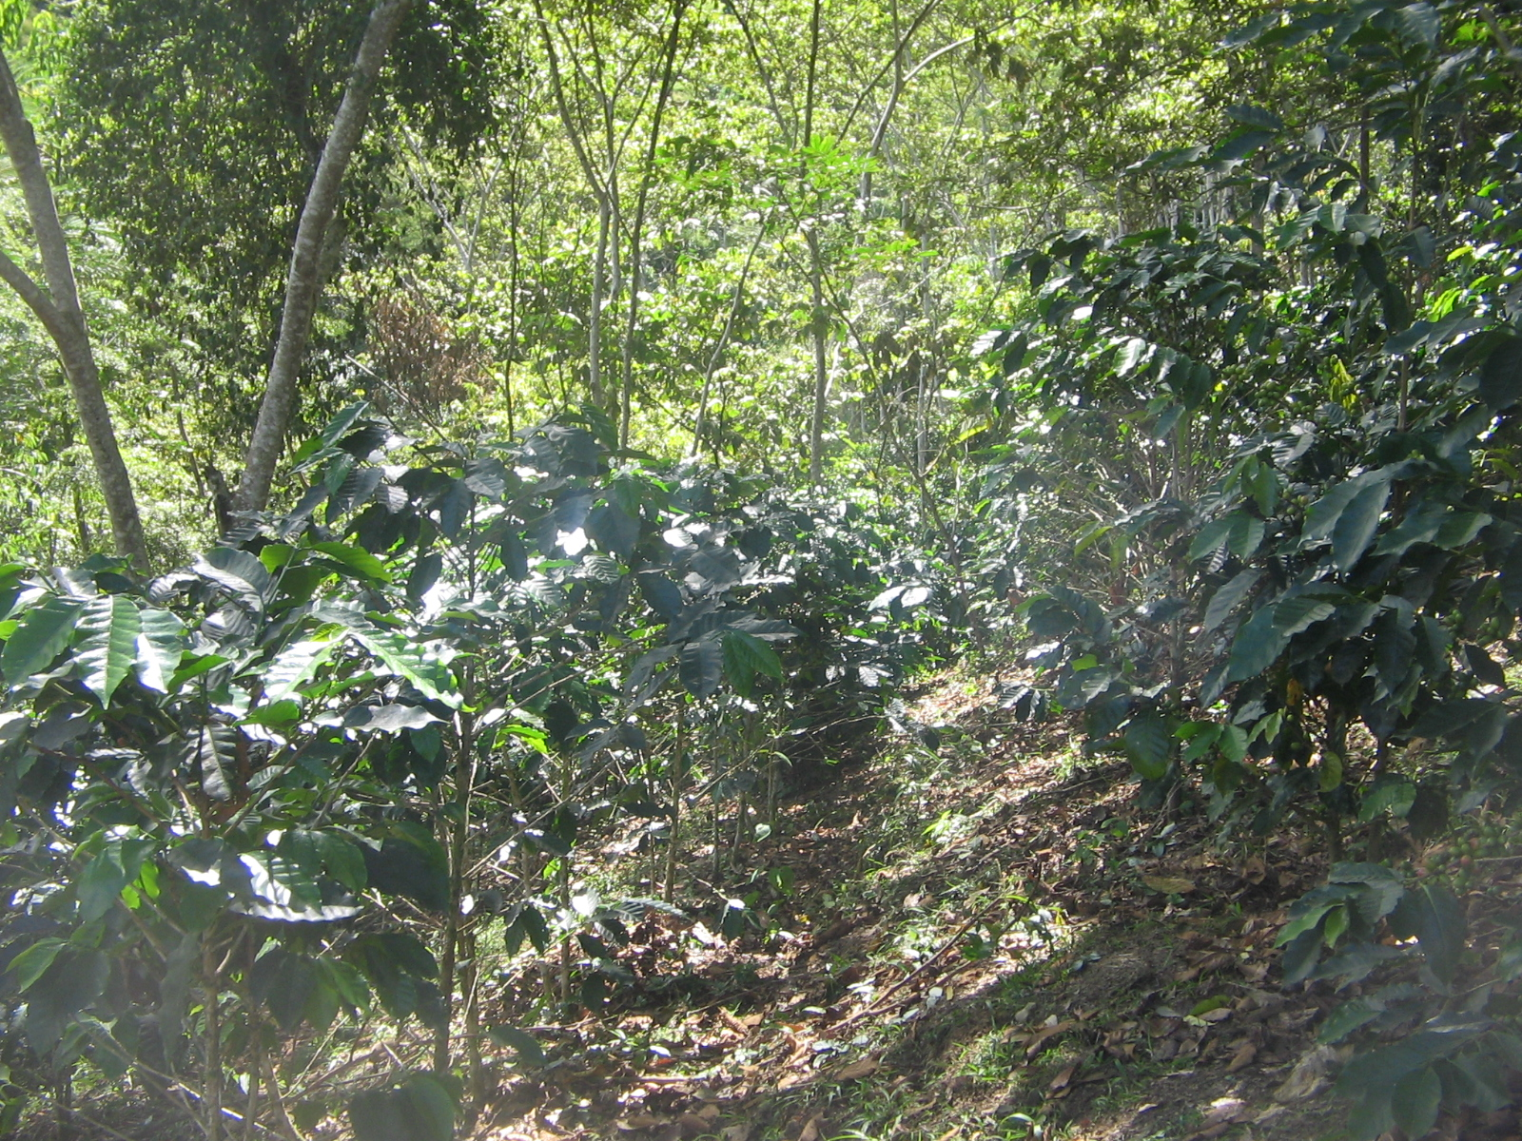
Agro eco zones:
HUMID VALLEY
(Peruvian Amazon)

Slide 12
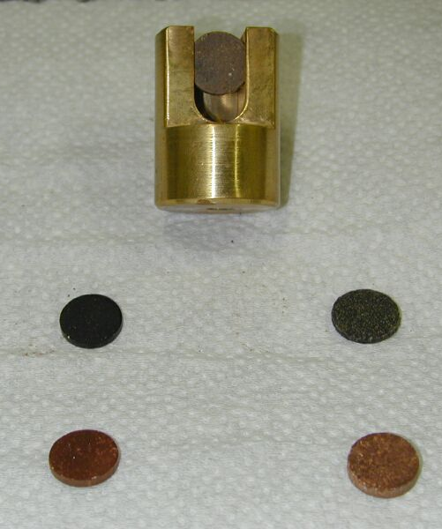
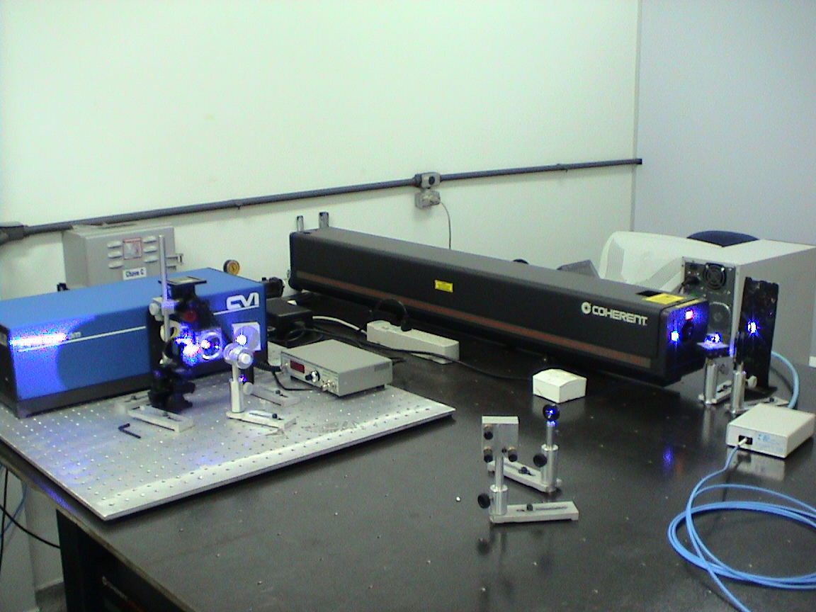
Laser Induced Fluorescence (LIF) Pellets of whole soil samples analysis

Slide 13
Emission spectrum of LIF
_{excitation} = 458 nm
Humification Degree:
H_{LIF} = LIF _{Area}/total carbon
Milori et al., SSSAJ, 2006.; González-Pérez et al., Geoderma, 2007

Slide 14
RESULTS - Carbon stocks
Soil carbon stocks (Mg ha⁻¹) by soil layer and total (0-30 cm). Data from soils sampled in 2008, in different cropping systems in Peru.
Depth (cm) | Ilo |  | Moquegua |  |  | Torata |  | Puno | Peruvian Amazon
 | A₁* | B₁* | A₂* | B₂* | C₂* | A₃* | B₃* | A₄* | A₅* | B₅*
0-2.5 | 4.4 | 3.6 | 5.9 | 4.7 | 6.5 | 7.4 | 11.9 | 3.7 | 10.6 | 8.3
2.5-5 | 4.0 | 3.4 | 4.9 | 4.7 | 6.4 | 7.6 | 10.8 | 3.8 | 9.2 | 7.0
5-10 | 6.8 | 6.5 | 7.2 | 9.0 | 11.3 | 14.8 | 15.9 | 9.8 | 15.3 | 11.1
10-20 | 13.4 | 12.8 | 19.5 | 18.0 | 23.3 | 22.4 | 28.3 | 17.2 | 32.2 | 26.5
20-30 | 13.8 | 11.8 | 19.2 | 19.2 | 17.7 | 16.0 | 25.0 | 12.4 | 24.0 | 22.3
0-30 | 42.4 | 38.1 | 56.7 | 55.6 | 65.2 | 68.2 | 91.9 | 46.9 | 91.3 | 75.2
# CARBON STOCKS = 10 × (C × d × T); C is the carbon content in g kg-1; T the sample layer thickness in meters and d the soil layer bulk density in Mg m-3;
* A1: maize; B1: olive; A2: alfalfa; B2: potato-alfalfa-maize rotation; C2: grape; A3: avocado-citrus-maize-potato-cassava; B3: alfalfa; A4: alfalfa–potato–oat rotation; A5: coffee (agroforestry); B5: rainforest;

Slide 15
Carbon stocks vs. altitude
Relationships between total soil Carbon stocks and altitudes from different agroecozones.

Slide 16
LIF results
Humification degree or carbon stability (HLIF) of whole soils obtained through Laser Induced Fluorescence (LIF) spectroscopy.
 | H_{LIF} (a.u.) #
Depth (cm) | Ilo | Moquegua | Torata | Puno | Peruvian Amazon
0-2.5 | 24.5±0.8 | 20.6±0.1 | 14.5±0.1 | 16.1±0.1 | 8.1±0.1
2.5-5 | 26.3±0.0 | 22.0±0.1 | 15.7±0.2 | 16.9±0.2 | 9.5±0.0
5-10 | 26.5±0.7 | 22.4±0.1 | 17.5±0.4 | 17.7±0.1 | 10.9±0.1
10-20 | 26.4±0.8 | 23.7±0.1 | 24.1±0.2 | 21.0±0.8 | 12.7±0.1
20-30 | 28.3±0.5 | 25.0±0.3 | 28.3±0.2 | 24.6±0.1 | 18.7±0.1
# H_{LIF} can be estimated through the ratio of area under fluorescence emission (excitation range 350 - 480 nm) by total organic carbon content.

Slide 17
Final considerations
Well managed coffee plantations in the Amazon site and alfalfa under irrigation in the high dry valleys presented as much carbon stocks as primary rainforests;
The dry lowlands showed the lowest carbon stocks values;
Carbon stocks were analyzed as a function of altitude (r ~ 0.8) for different agroecologies, within the same texture class;
potential of using spectroscopic systems of highly reliable results for field-level analysis of carbon contents and their degree of humification. The H_{LIF} ratio can be used to discriminate, in whole soils, the variation in degree of humification at depth for different crops and tillages, showing the effect of constant accumulation of plant residues in the topsoil.
The degree of humification is higher in cropping systems than in primary forests indicating that carbon stocks in cropping systems tend to be more recalcitrant;
The non incorporation of fresh available residues containing compounds necessary for the metabolism of microorganisms leads them to decompose the organic matter already existing in the soil more thoroughly;
The soils in the Amazon site presented lower stability. Higher soil carbon stability increased with depth, due to the presence of recalcitrant carbon, while at the surface the presence of labile carbon dominates due to constant input of plant residues.

Slide 18
Future works
evaluation of portable optical techniques for future agriculture applications in soil characterization.
The portable LIF (optical sensor) might evaluate the soil organic matter in the field, connected to a GPS for producing soil quality maps.
A portable LIBS (Laser Induced Breakdown Spectroscopy) system is also promissory equipment. LIBS can carry out quantitative field analysis of carbon contents and other elements in the soil.
With these new tools, soil carbon sequestration studies as well as macro and micro soil nutrients assessment for soil amendments and contaminants in the soil can be implemented in the field without (or minimal) sample preparation.

Slide 19
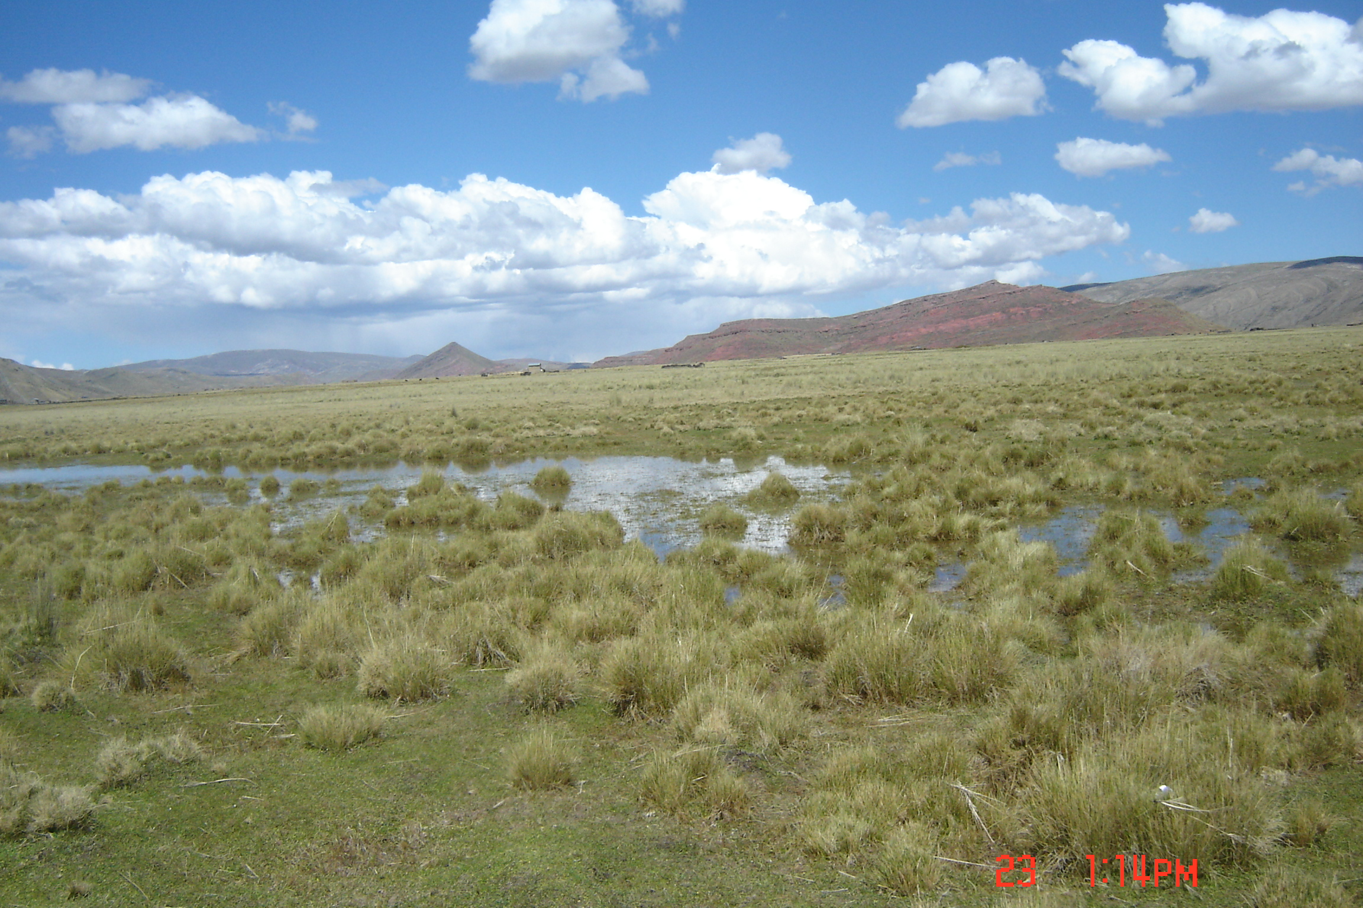
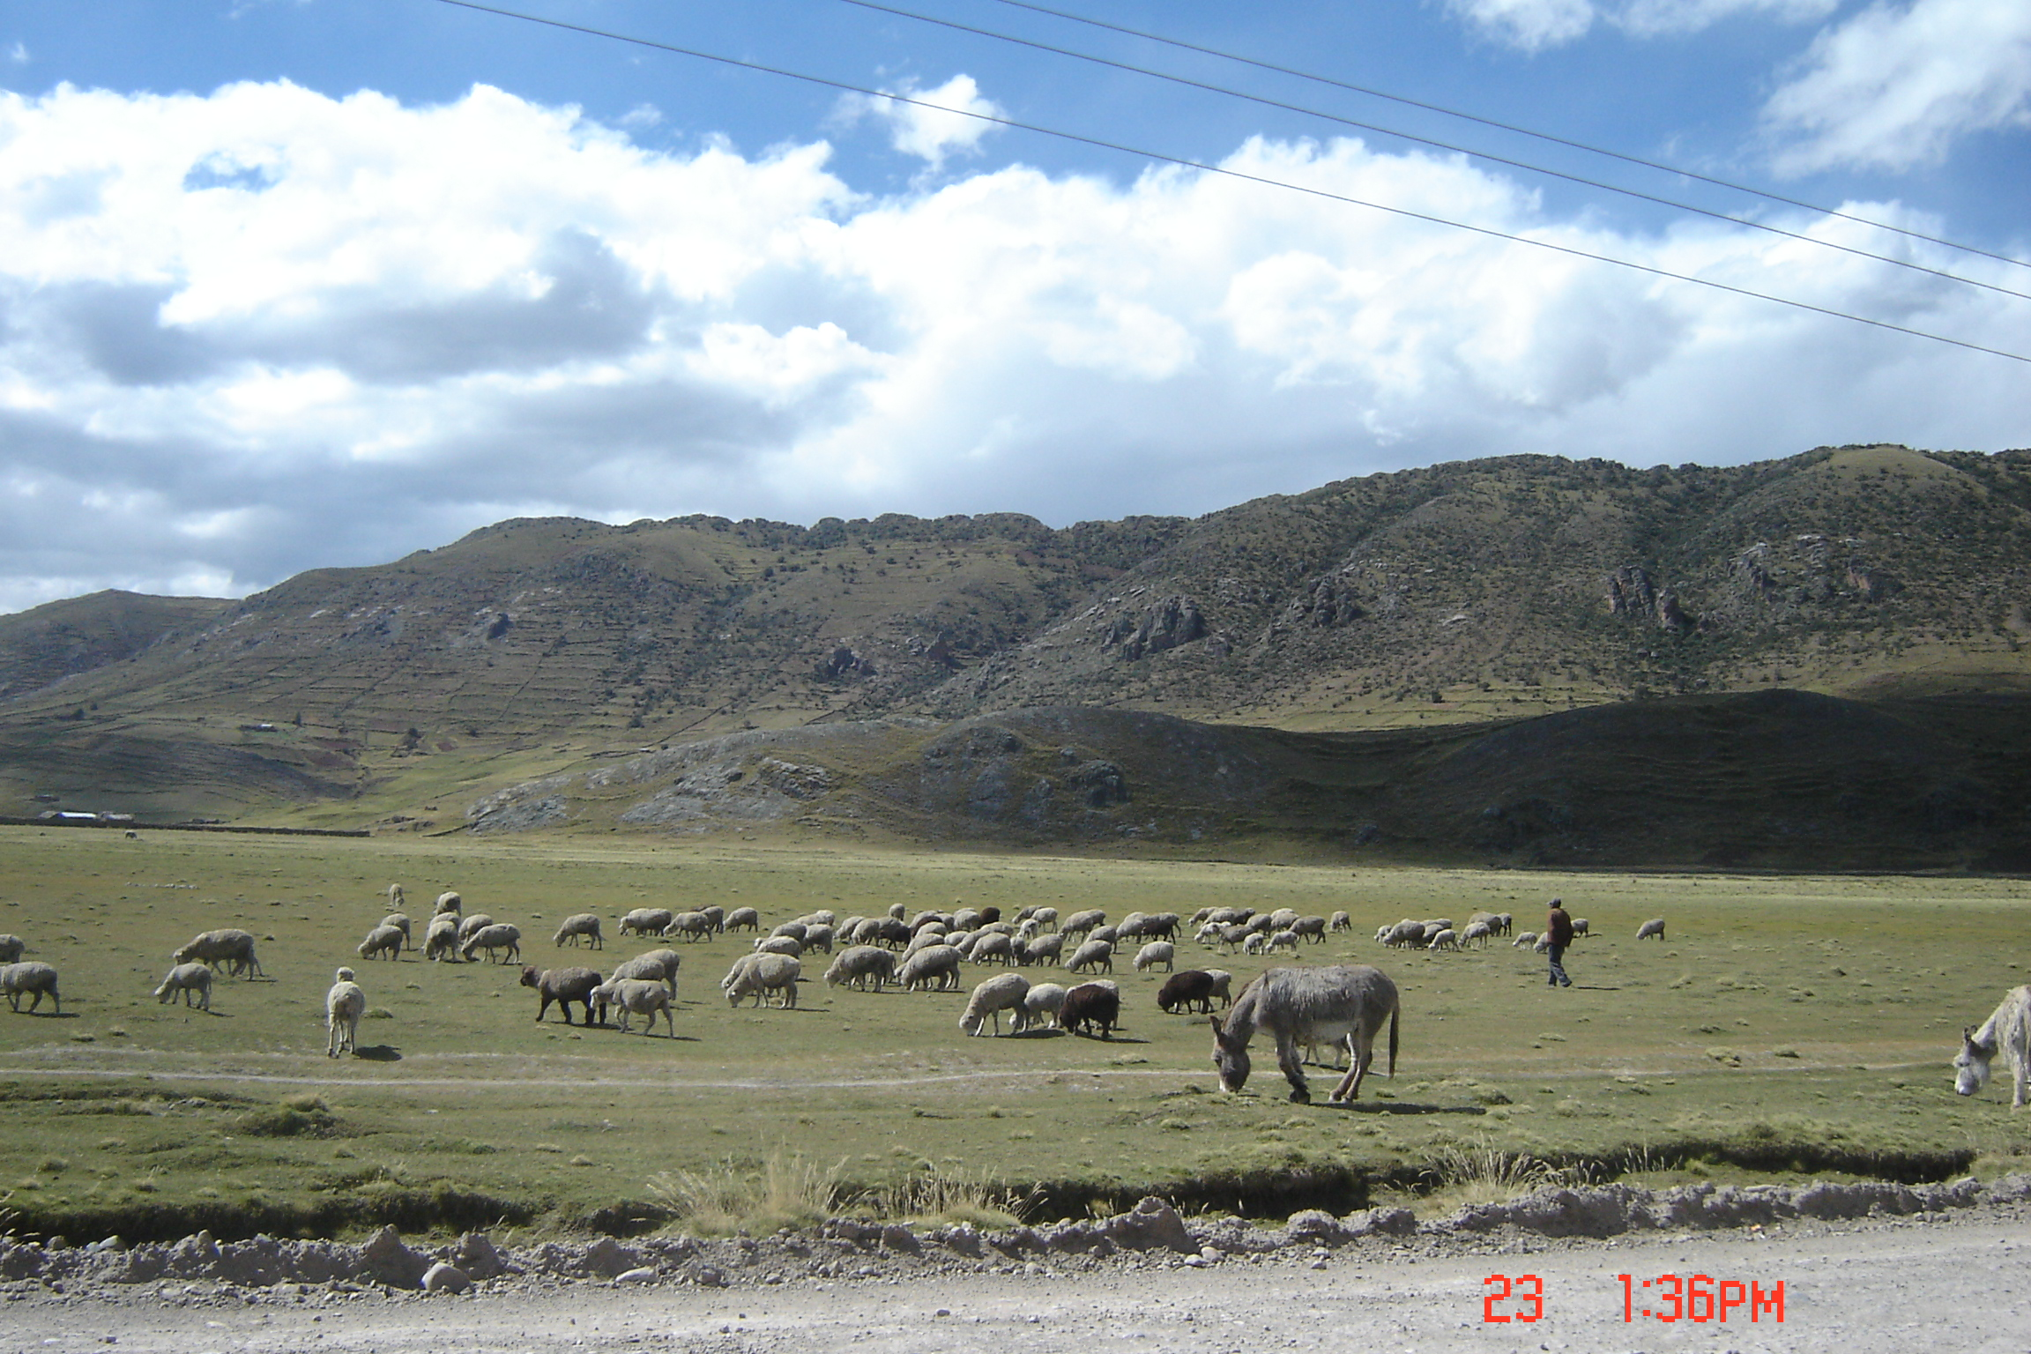
Evaluación espectroscópica de la materia orgánica del suelo en humedales alto andinas
Los bofedales sin duda representan uno de los ecosistemas más vulnerables en el mundo, ya que su localización y fragmentación dentro de una matriz ambiental seca son extremadamente sensibles al cambio climático (cambio del caudal de los glaciares, impacto de la elevación de las temperaturas) y al disturbio humano (cambio del uso del suelo, quema, actividad minera, drenaje, etc.
El bofedal no es un pasto sino un ecosistema determinado por la humedad del suelo, la que es alta generalmente determinada por agua superficial procedente de los glaciares.

Slide 20
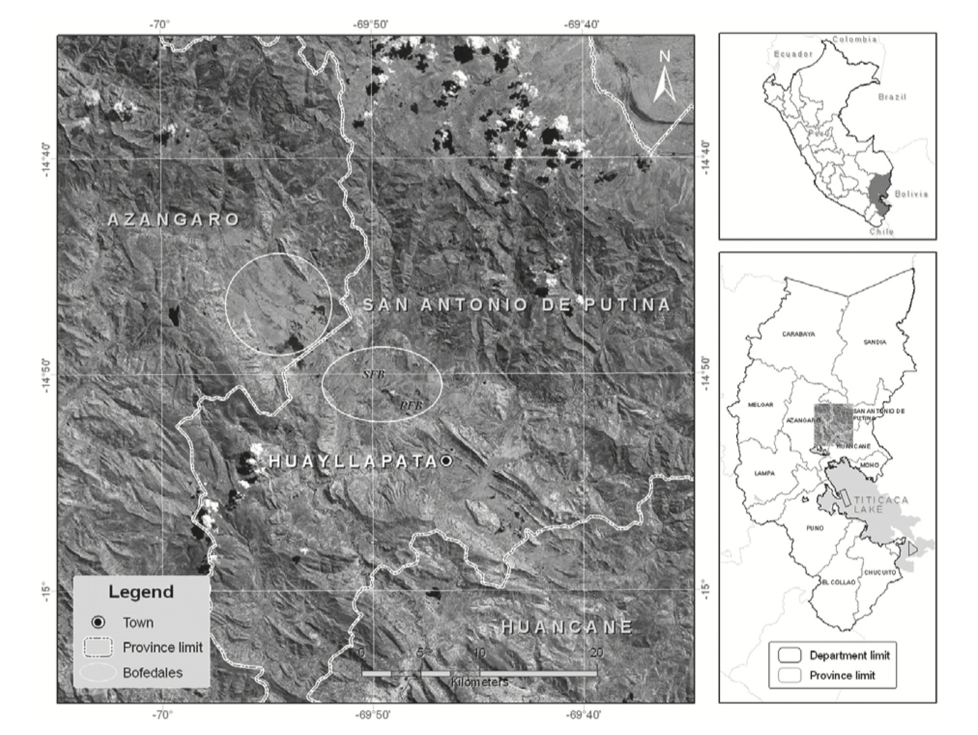
Fig. 1. location of the study area in the High andes highlighting the presence of permanently (PFB) and seasonally (SFB) flooded bofedales in the sampling site.

Slide 21
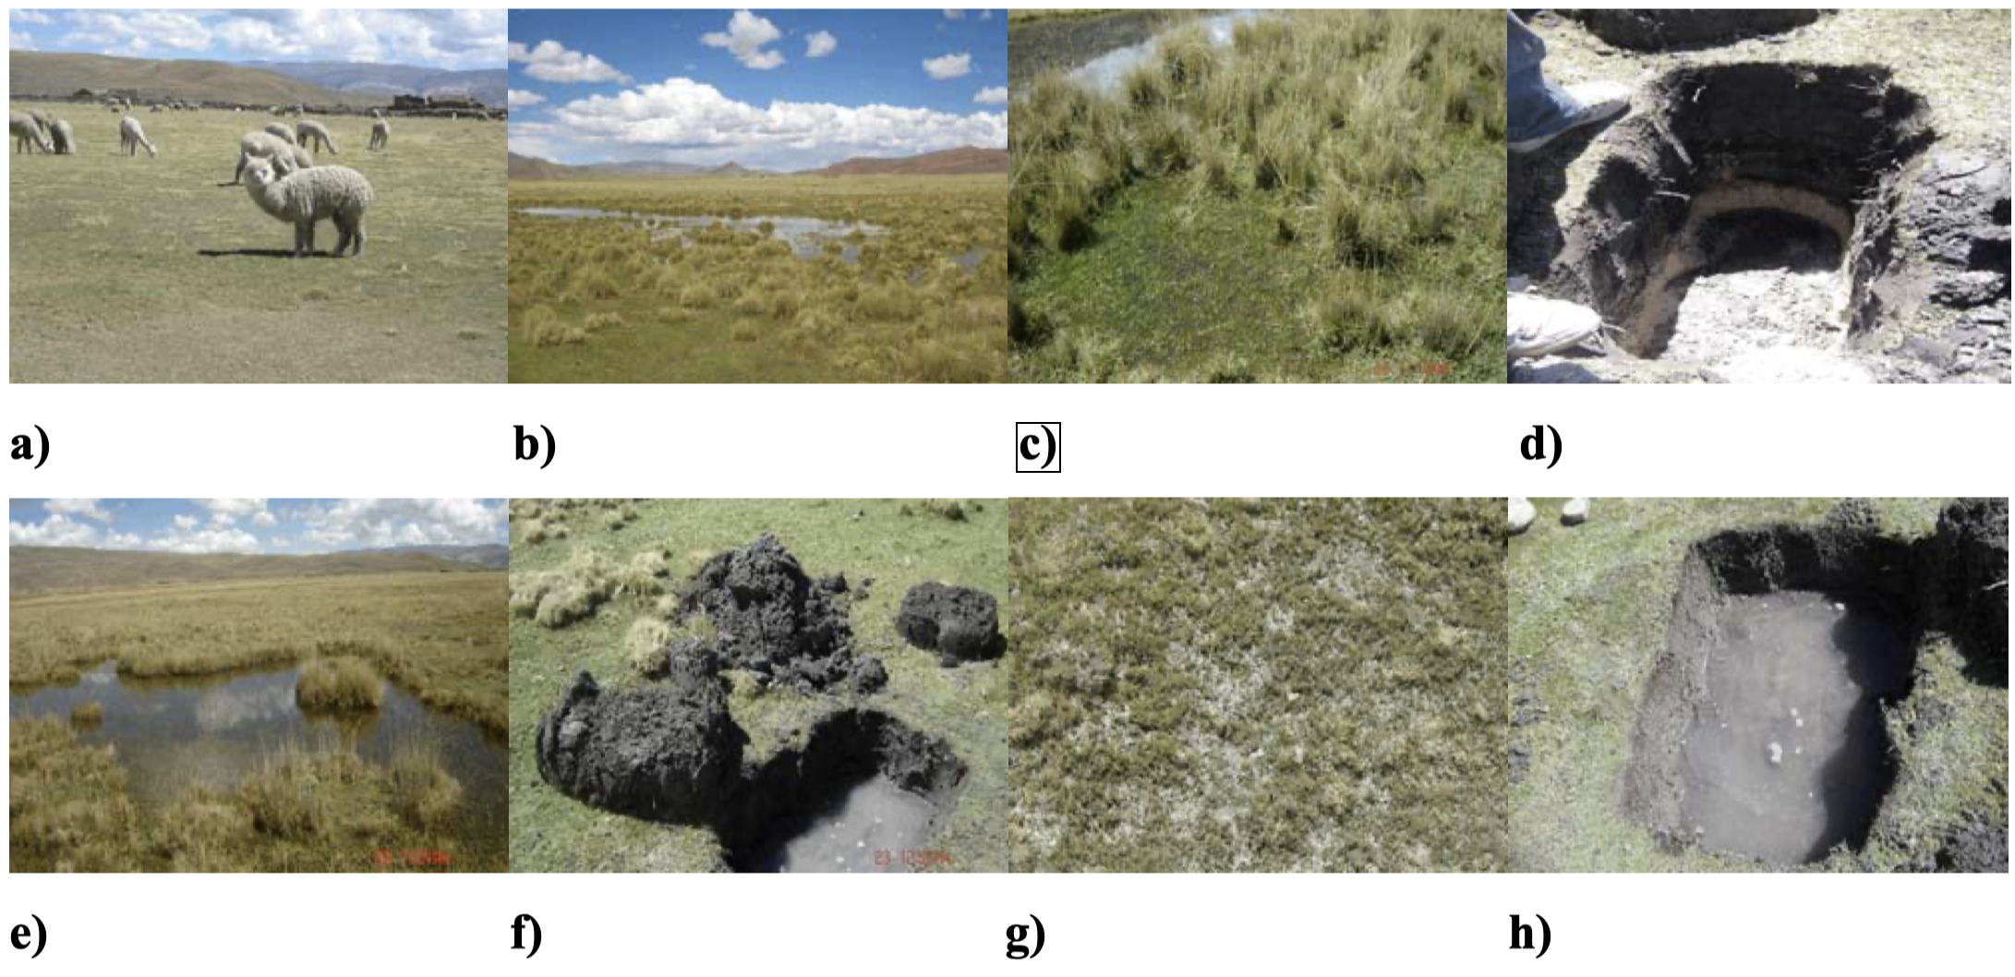
Muestreos en áreas de bofedales
Figura 6. a) Área de bofedales (pastos nativos, inundados), donde hay pastoreo de especies nativas: llamas, alpacas y vicuñas, además de ovejas, b) Bofedales típicos, c) Vegetación de bofedales, d) Presencia de dos perfiles o horizontes del suelo Área donde no había mucha agua (región más seca), e) Área de bofedales (región más inundada), f) Vista de una zanja, con presencia de agua en una profundidad de 25-30 cm, g) Vegetación típica, h) Vista de una zanja, destacando la presencia de agua en aproximadamente 25 cm de profundidad.

Slide 22
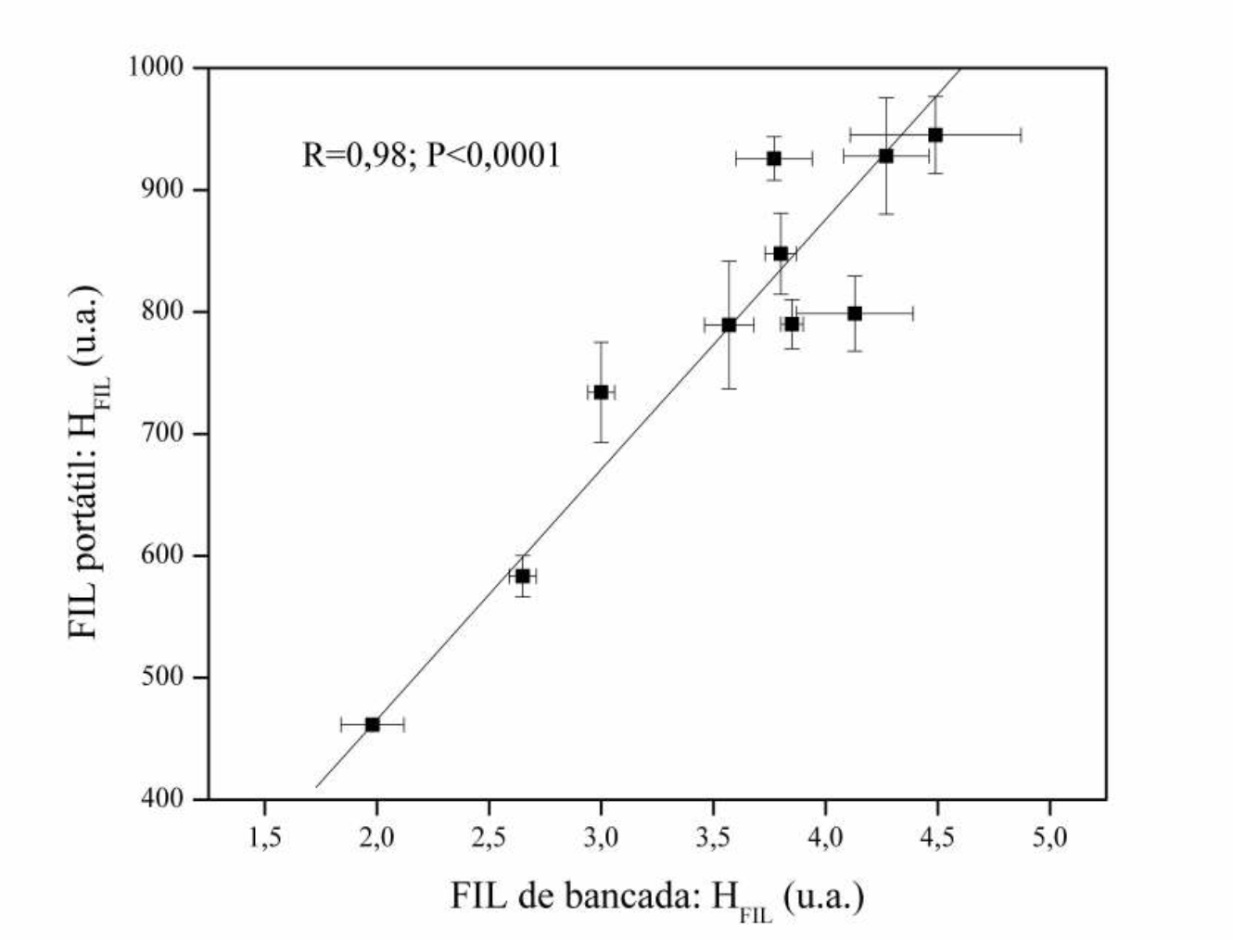
Resultados
Figura 3. Relación entre los índices de estabilidad de carbono analizados por espectroscopía de fluorescencia portátil inducida por láser (FIL) con instrumentación de banco de FIL.

Slide 23
Tabla 1. Datos de carbono (g kg⁻¹), densidad (g cm⁻³) y secuestro de carbono, SC (Mg ha⁻¹), en función de la profundidad (0-30 cm) en dos áreas de turberas andinas (Bofedales) de los Andes peruanos.
A partir de los valores obtenidos en la Tabla 1, se observa que en la región más preservada la concentración de carbono es más alta que en el suelo del área degradada, a todas las profundidades. Considerando solo la superficie (0-2.5 cm), el área preservada tenía 64% más de carbono que en el área degradada. El contenido de carbono disminuye a medida que aumenta la profundidad, en ambos casos. En suelos inundados, como en los Bofedales, a medida que aumenta la profundidad, aparece agua. Esta agua, que se encuentra en mayor cantidad en el área preservada (Figura 1b), hace que la densidad del suelo disminuya y, en consecuencia, se obtienen SC más bajas.

Slide 24
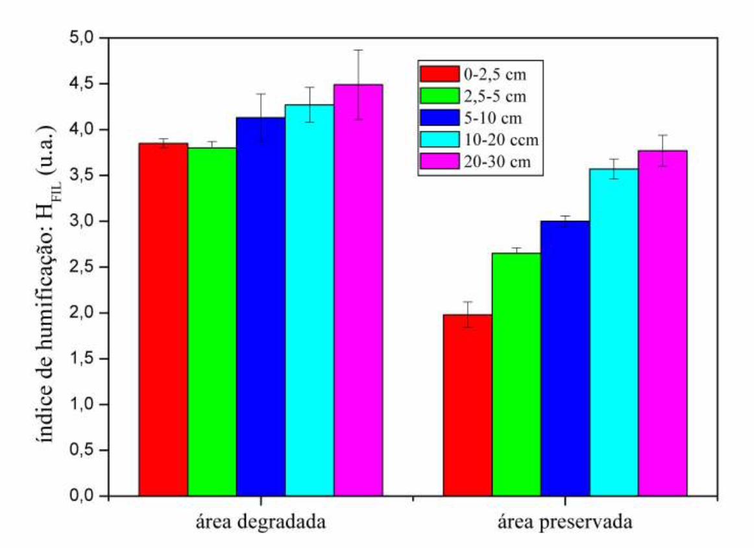
Figura 2. Índices de humificación o estabilidad (HFIL) del carbono del suelo obtenido por espectroscopia de fluorescencia inducida por láser (FIL) para las dos áreas de Bofedales recolectadas en los Andes peruanos a diferentes profundidades (0-2.5; 2.5 -5; 5-10; 10-20 y 20-30 cm).

Slide 25
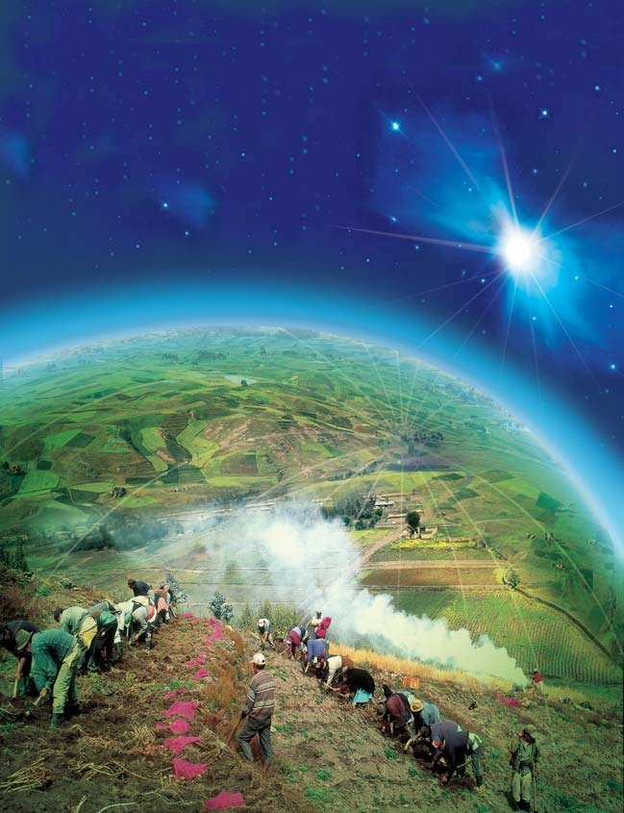
Agriculture
and
Soil
Carbon:
Playing a major role
in the mitigation of
climate change
GRACIAS !!

